Slide 1
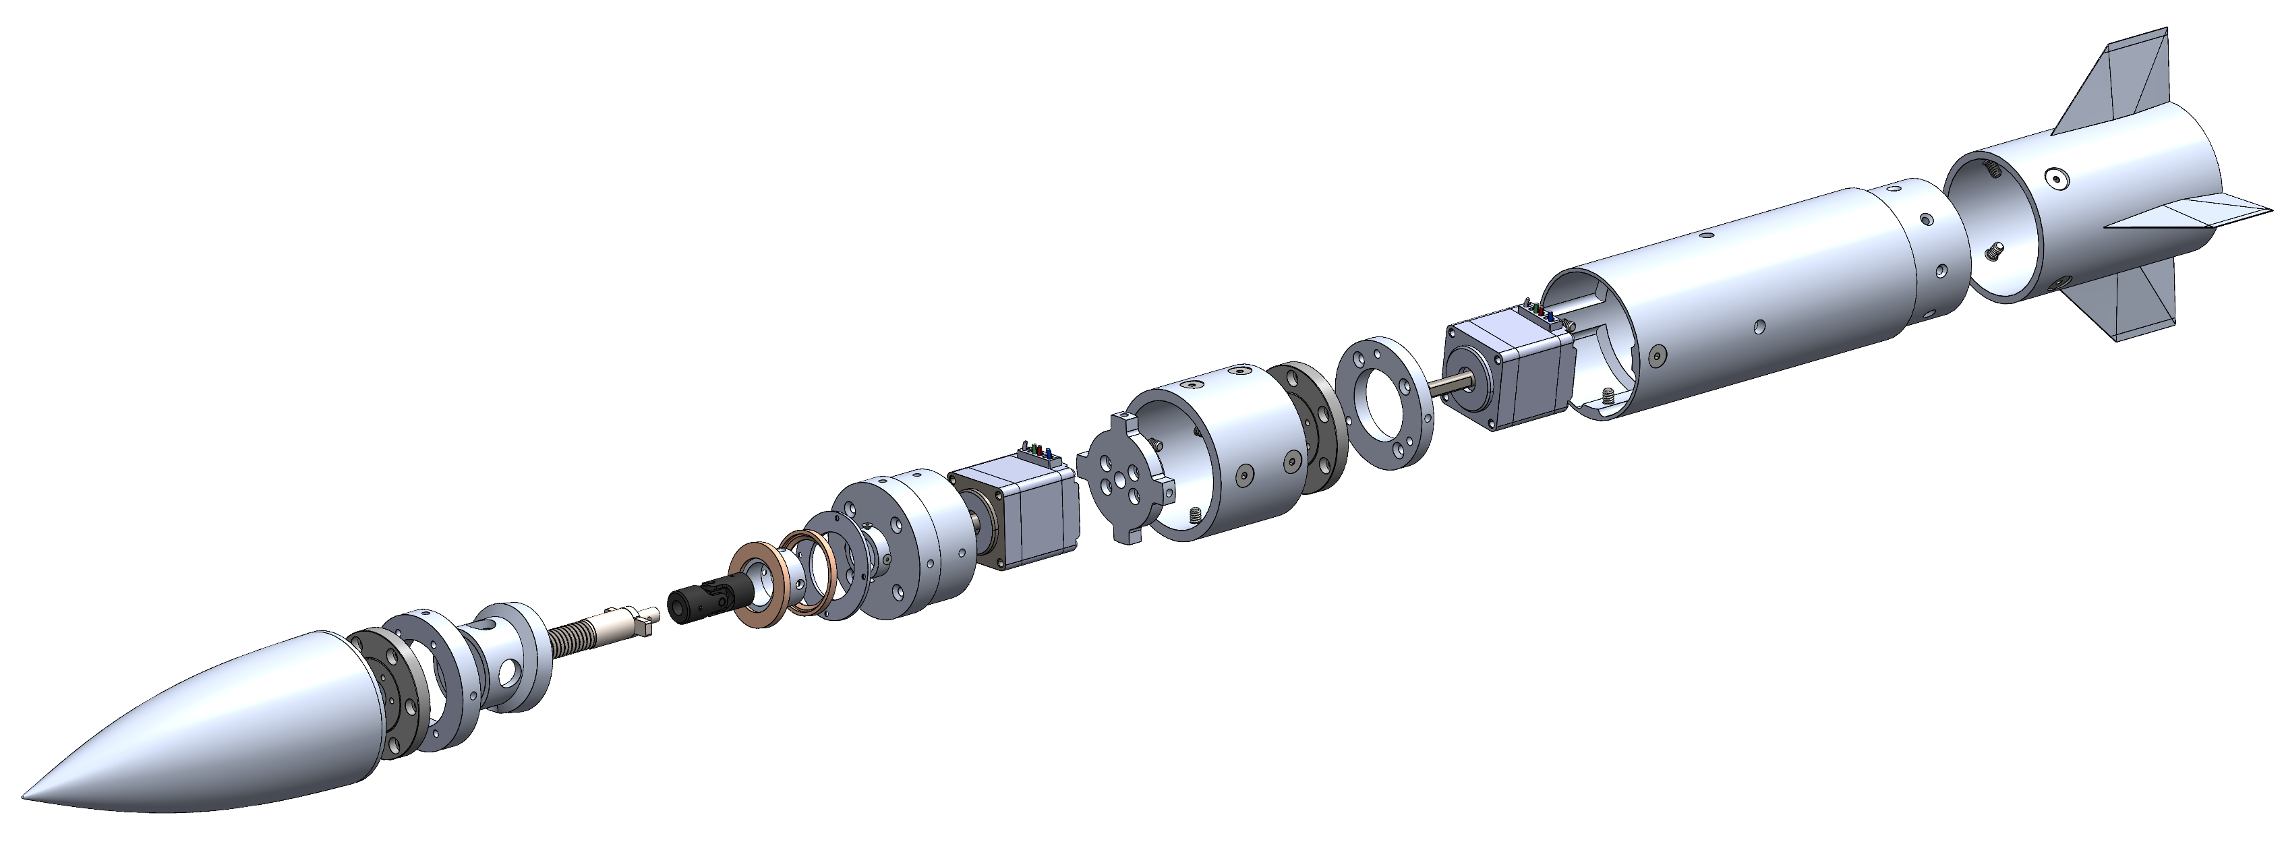
Articulating Nose Cone
Jed Fazler | Noah Moffeit | Nicholas Samuda | Robert Smith
Notes:
https://visualhunt.com/f7/photo/32891036558/2ed24545c0/

Slide 2

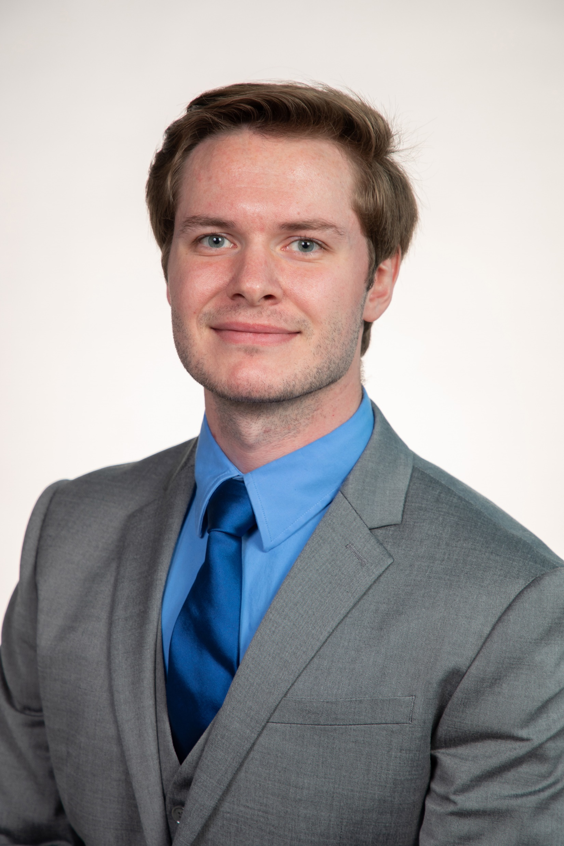
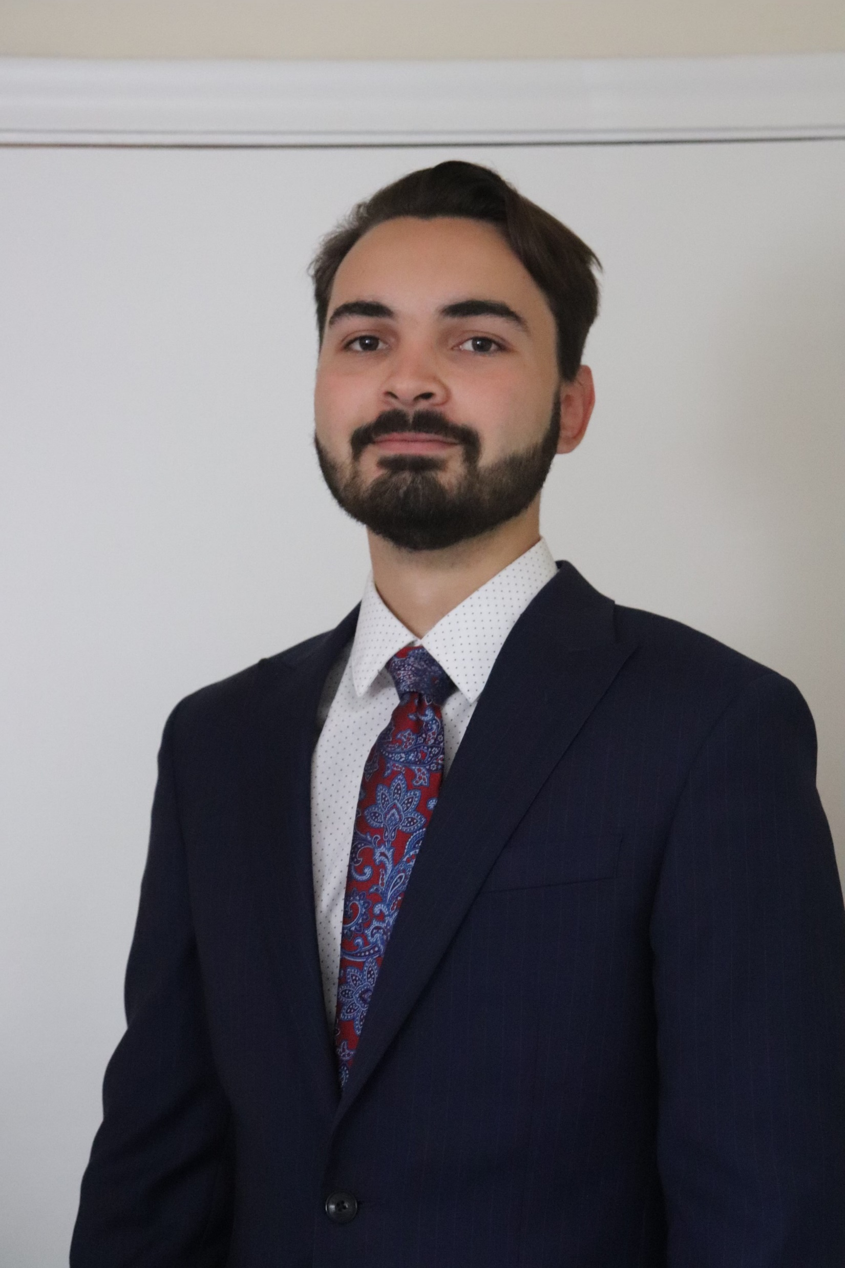
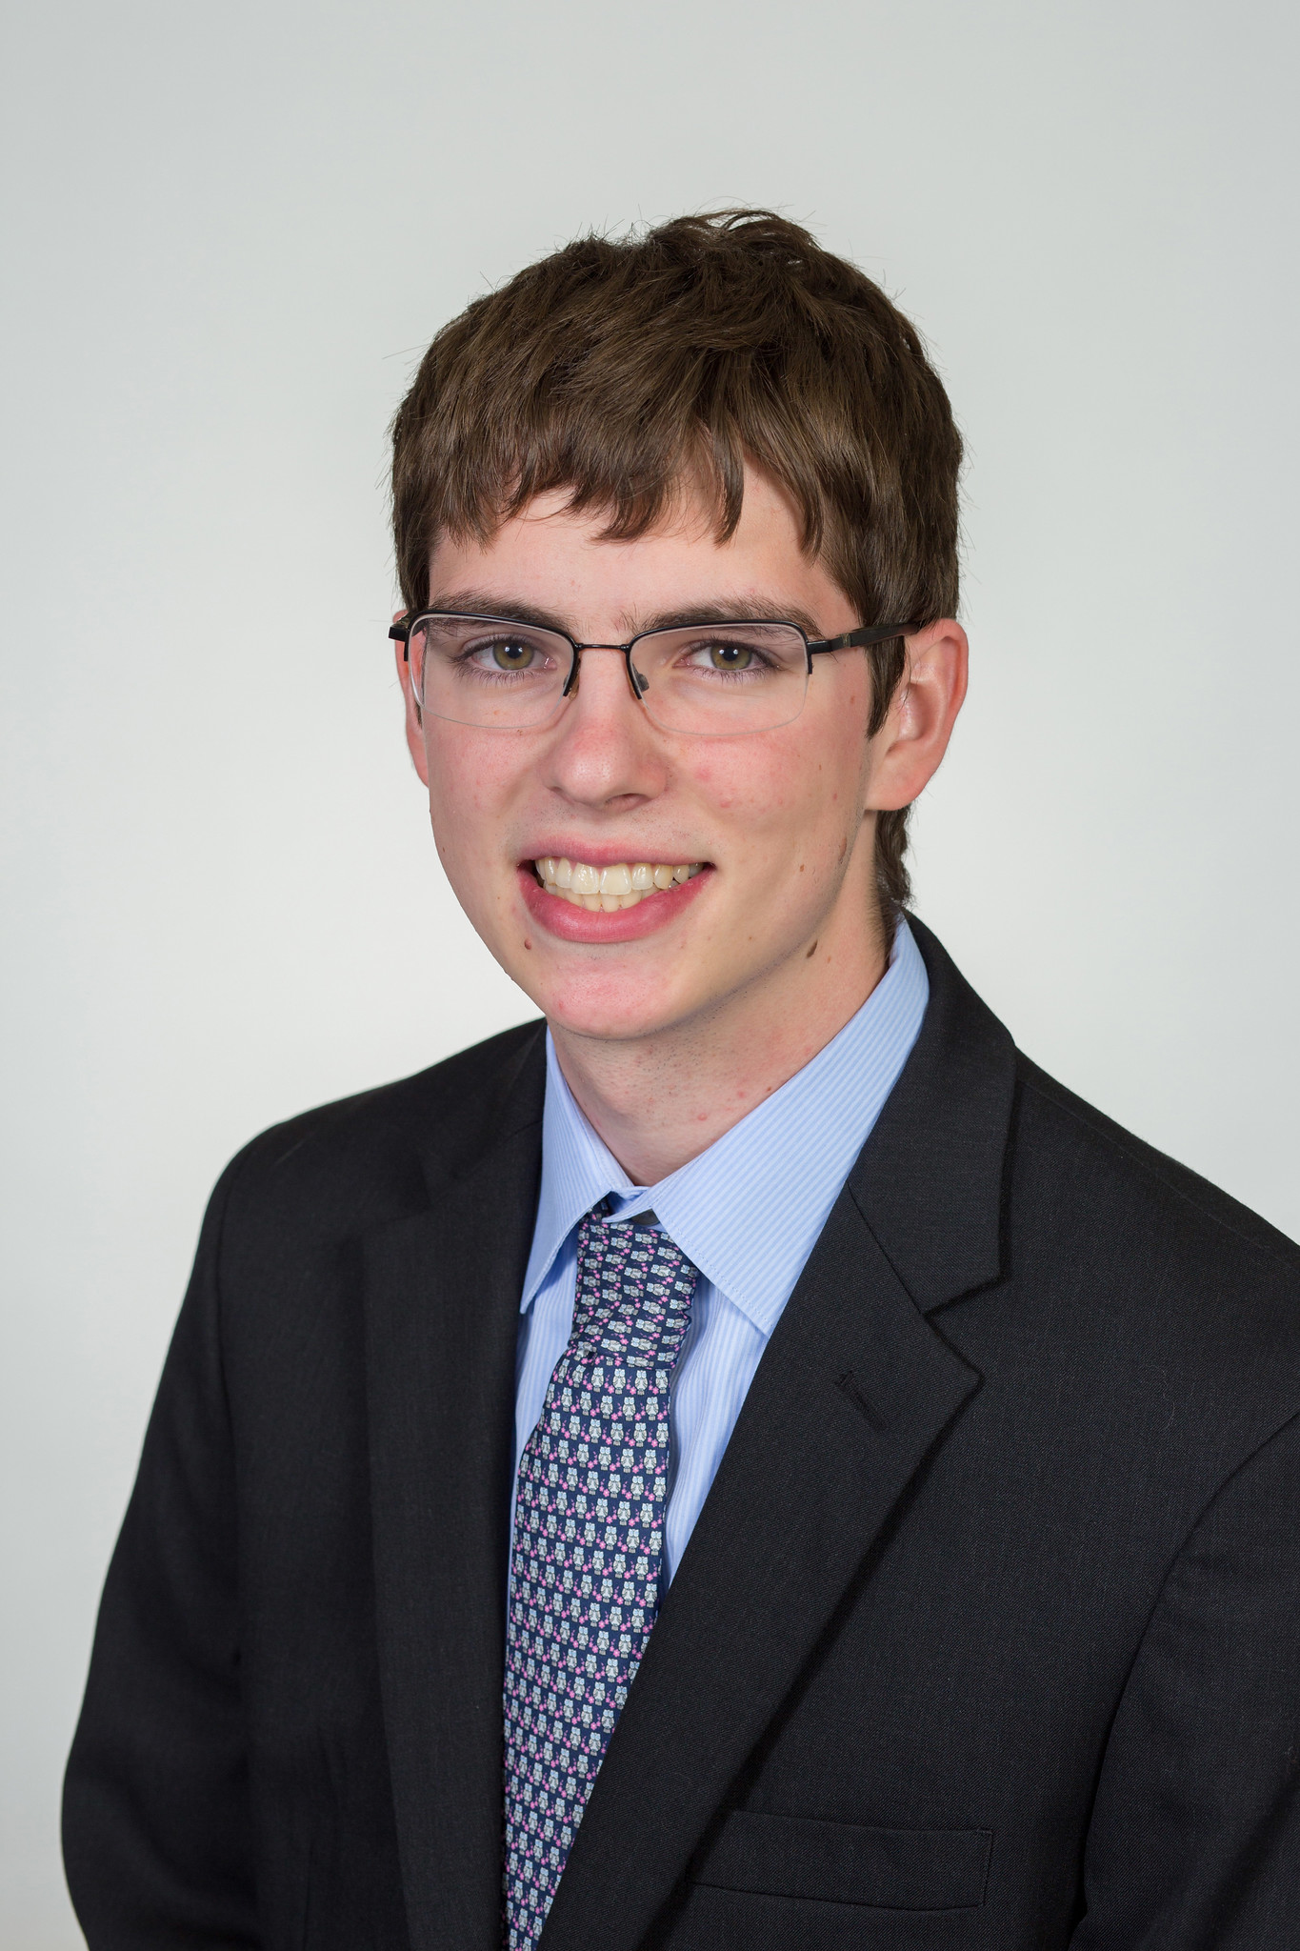
Team 504 Introductions
Jed Fazler
Materials Engineer
Noah Moffeit
Design Engineer
Nicholas Samuda
Systems Engineer
Robert Smith
Research Engineer
Jed Fazler

Slide 3
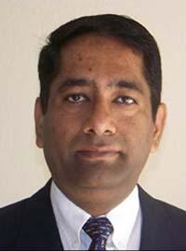
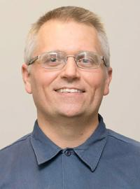

Sponsor and Advisor
Dr. Rajan Kumar
Dr. Jonas Gustavsson
Jed Fazler
Notes:
Our project sponsor is Dr. Rajan Kumar, he is an Associate Professor at the FAMU-FSU college of engineering and the Director of the Florida Center for Advanced Aero-Propulsion. Our project advisor is Dr. Jonas Gustavsson who works as an Associate Scientist at FCAAP.

Slide 4

Project Objective
The objective of this project is to create a method of articulation for a nose cone on a missile model while keeping a smooth edge transition.
Jed Fazler

Slide 5
Project Background
AFRL wants to investigate alternatives for fin deflection
Studies show nose deflection as a viable method of control
FCAAP is brought on to further study the effects of a deflecting nose
Articulating Nose Cone project begins
Jed Fazler

Slide 6
Critical Goals
Articulate the nose cone to obtain a pitch or yaw of ± 20°
Maintain a clean edge transition between nose and body
Pitch
θ
Yaw
Jed Fazler

Slide 7
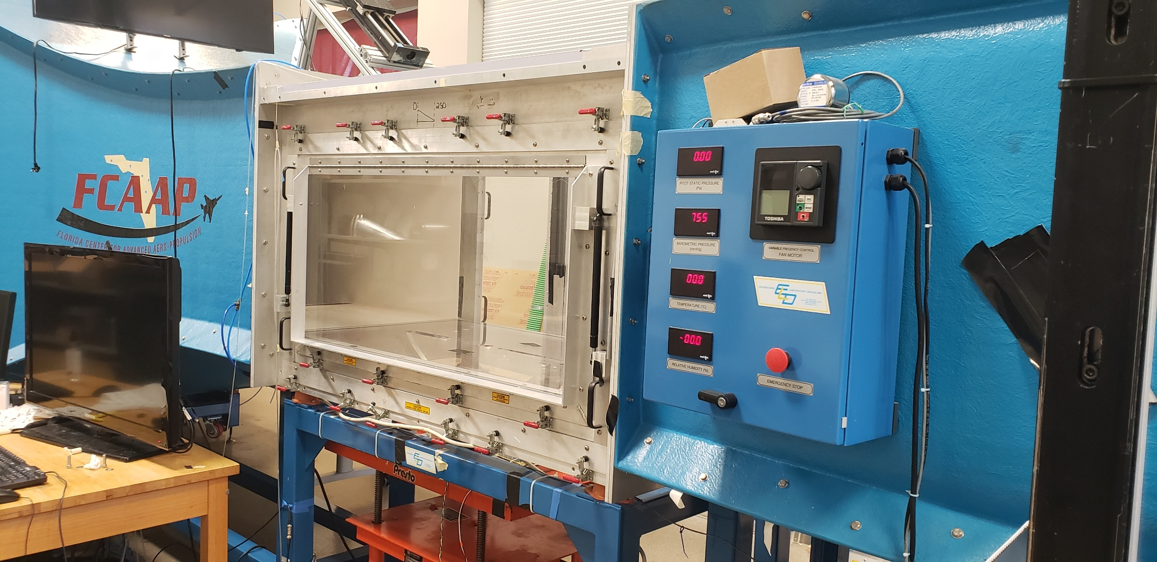
Additional Project Considerations
Implementation with available data acquisition systems
Scalability of the final design
Allow for varying pitching speeds
Jed Fazler

Slide 8
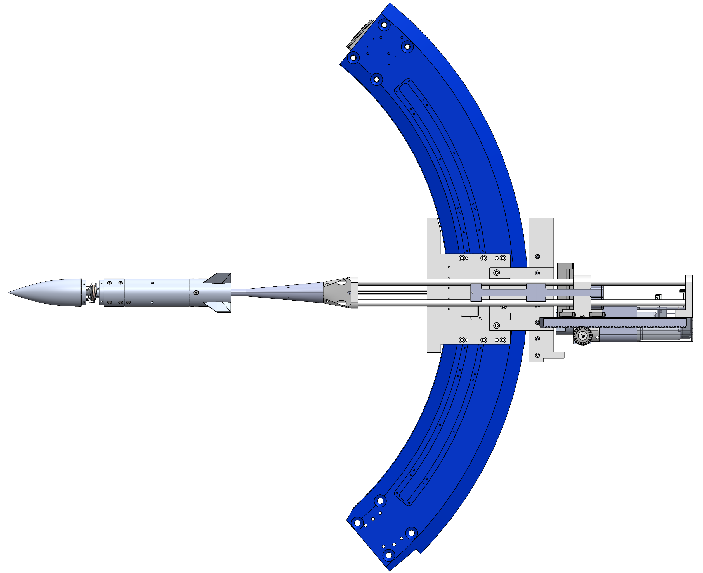
Assumptions
Wind tunnel
Arc sector
The ANC has access to power from outside of the wind tunnel
Wind tunnel controls are already in place for testing
The ANC can use the available arc sector for mounting
Airflow
Nicholas Samuda

Slide 9

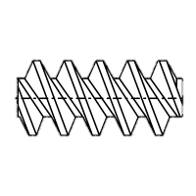
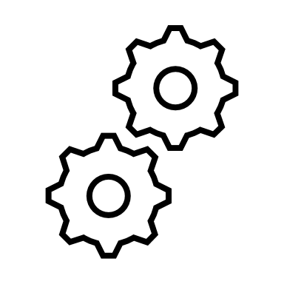

Concept Generation
Nose Pulleys
Linear Actuators
Concentric Surfaces
2 DOF Gear Box
Pin Slot Deflector
Belt Driven Nose
Nicholas Samuda

Slide 10
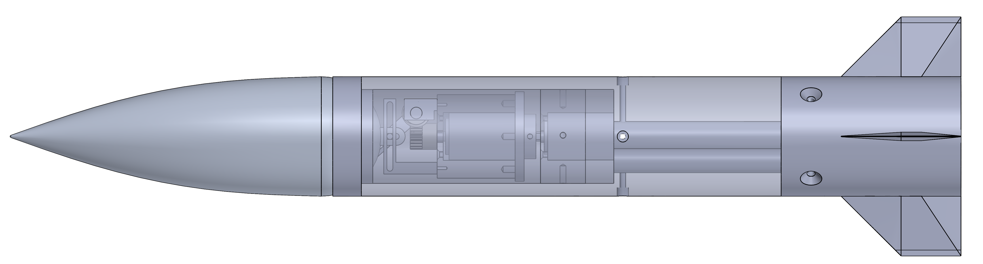
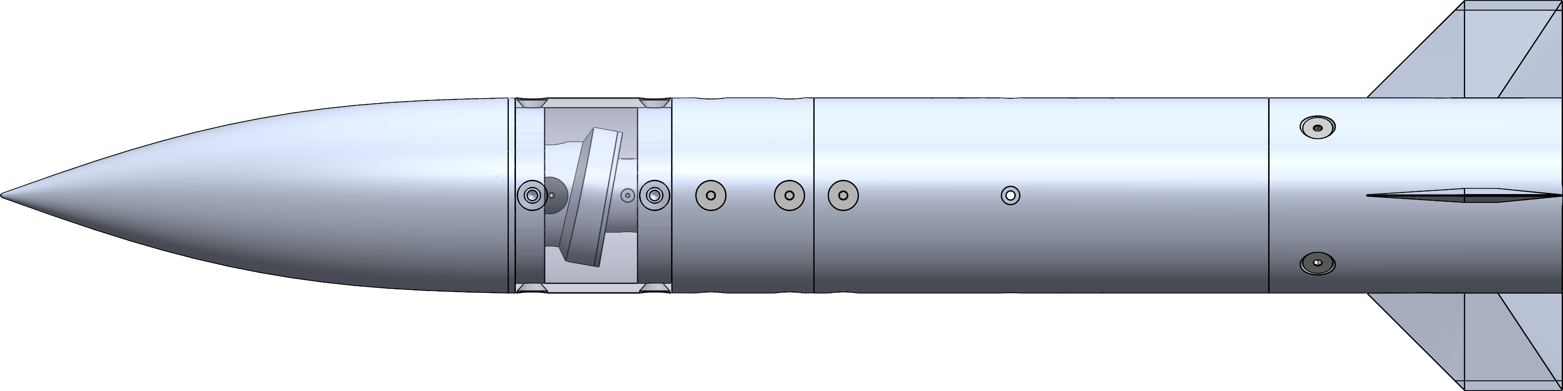
High Fidelity Concepts
Pin Slot Deflector
Concentric Surface
Nicholas Samuda

Slide 11
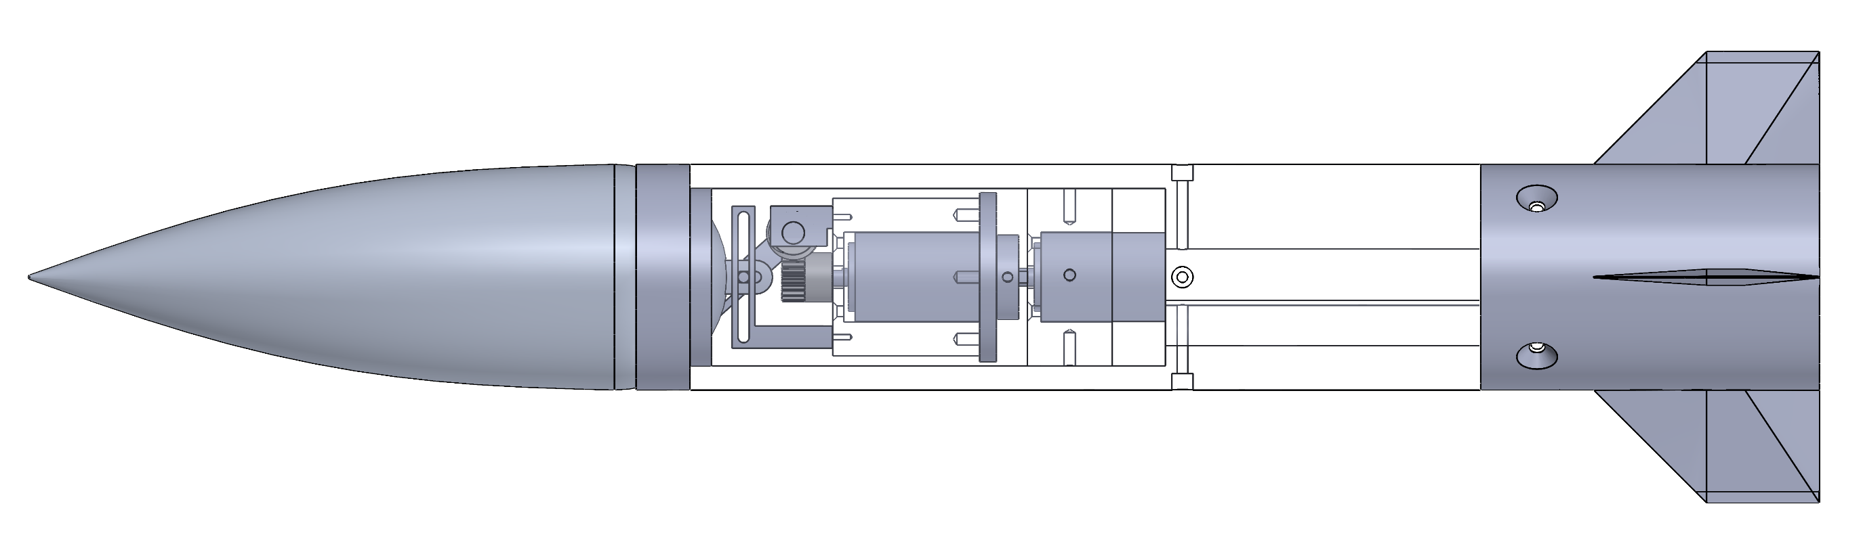
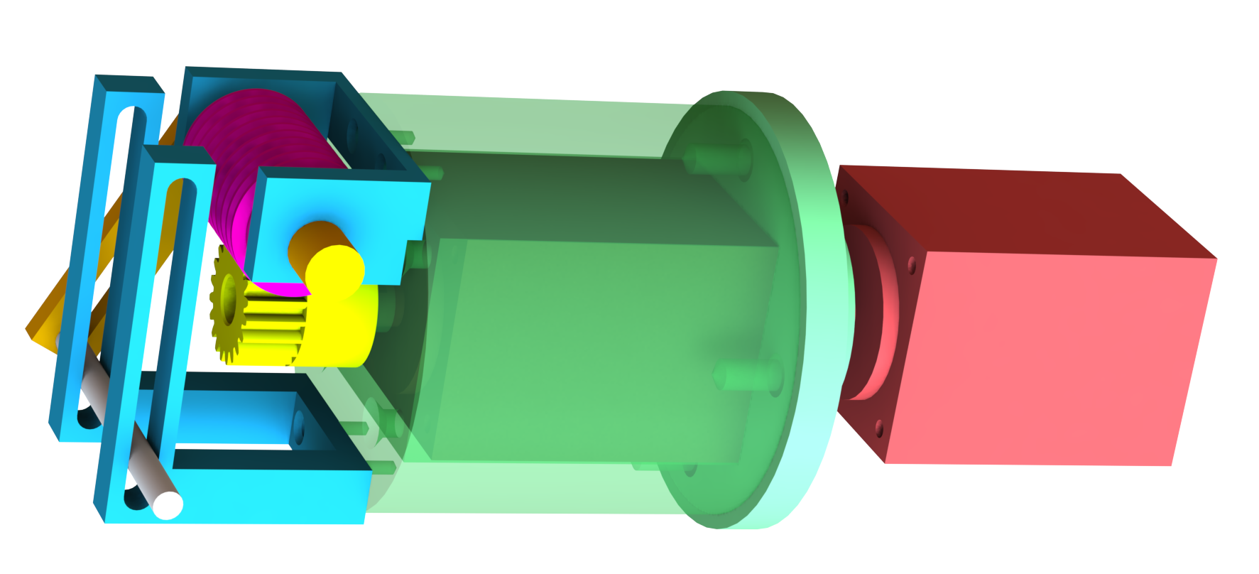
Pin Slot Deflector
Transforms motion using a worm gear
Drives nose deflection with a pin slot
Rotates nose with a second stepper motor
Nicholas Samuda

Slide 12
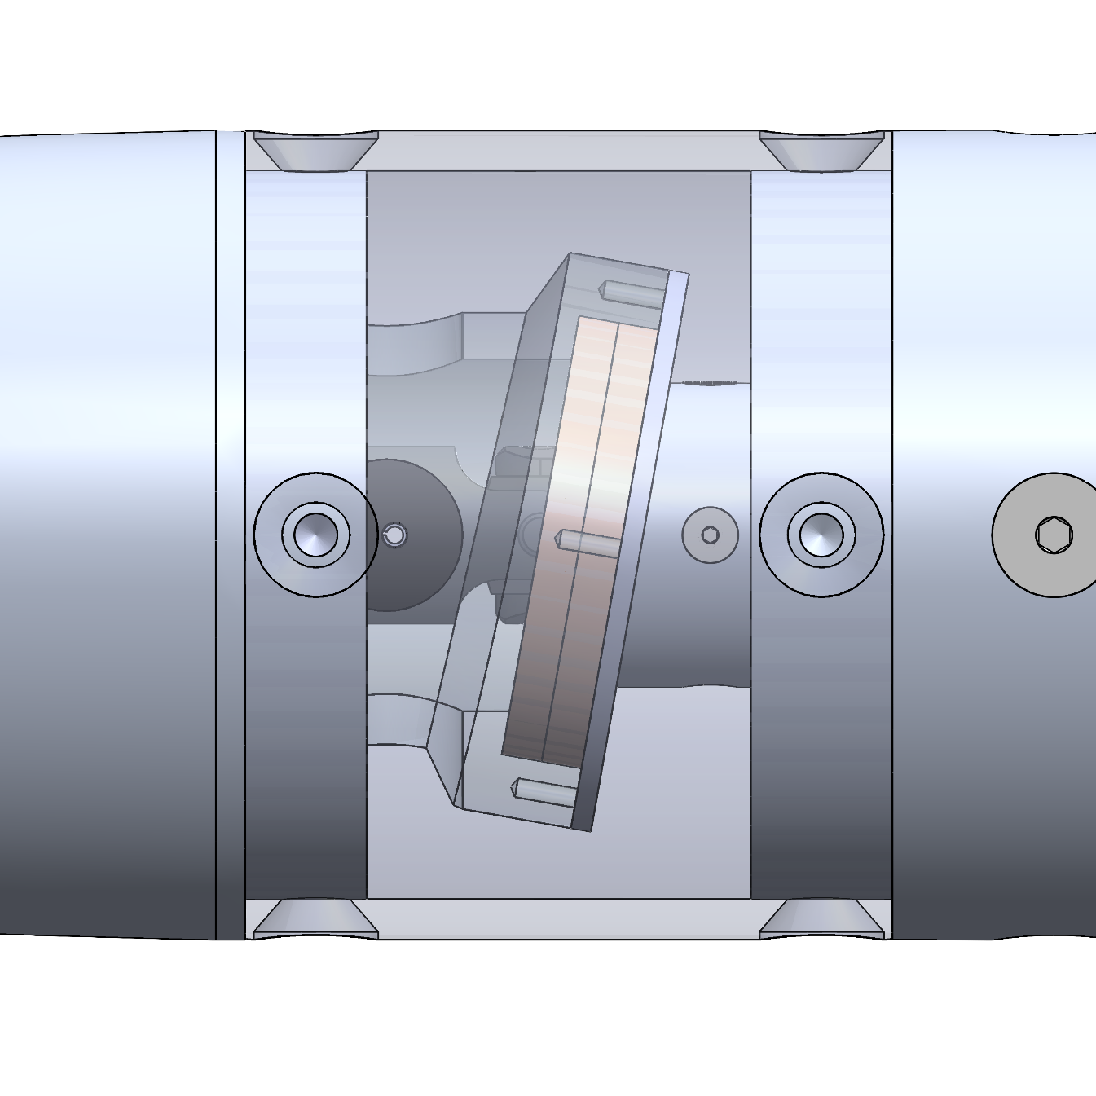
Concentric Surfaces
Implements the use of two angled surfaces for articulation
Uses two stepper motors for rotation and deflection
Translates power through a universal joint
Nicholas Samuda

Slide 13


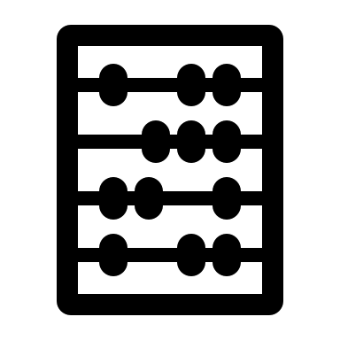
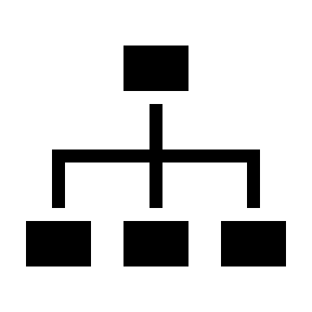
Concept Selection
Pairwise Comparison
House of Quality
Pugh Chart
Analytical Hierarchy Process
Nicholas Samuda

Slide 14
Selected Design – Concentric Surfaces
Nicholas Samuda

Slide 15
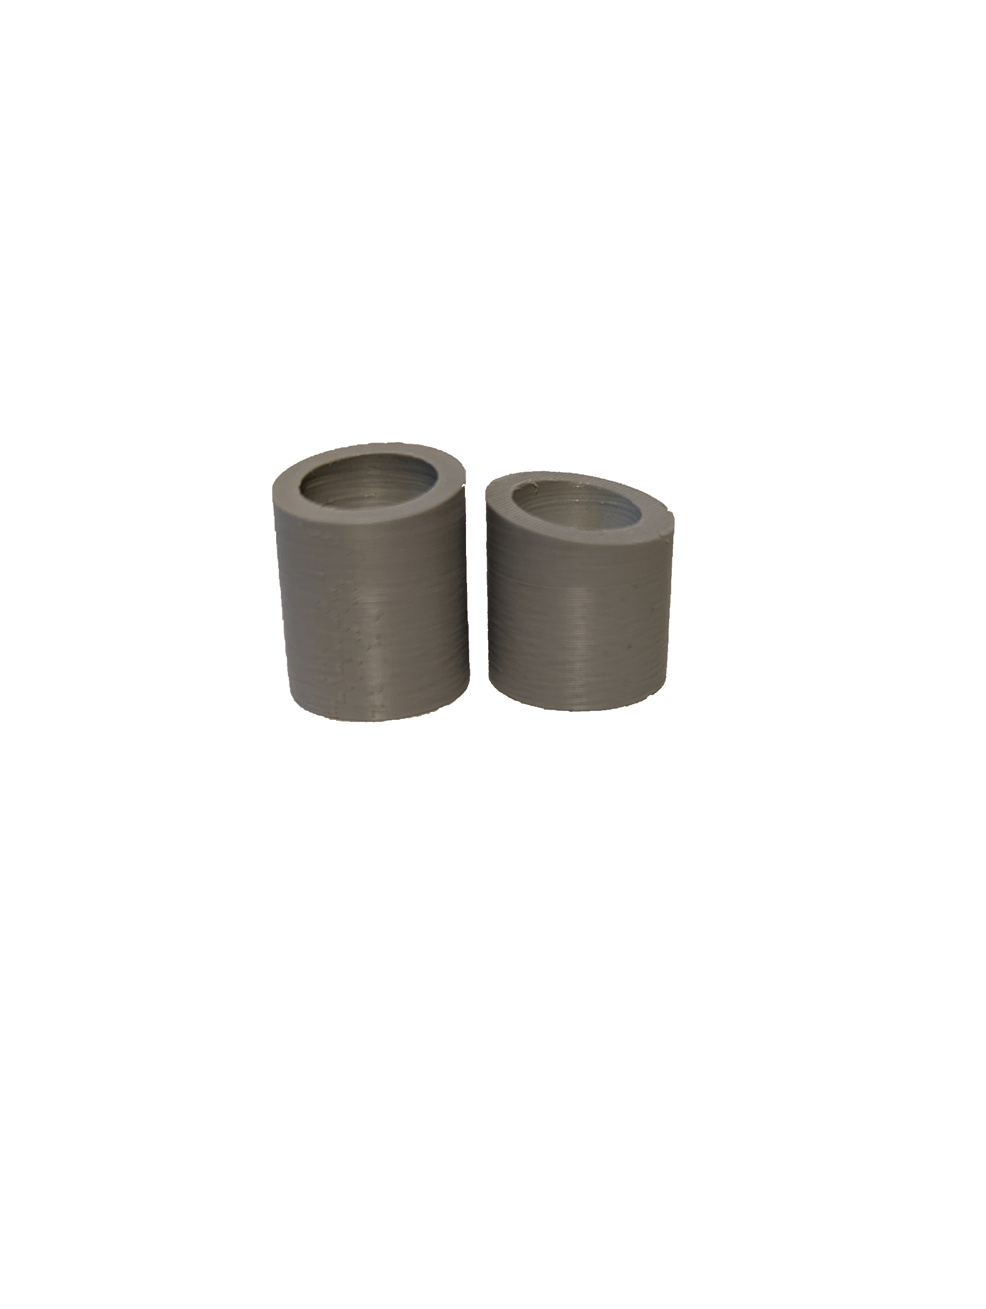
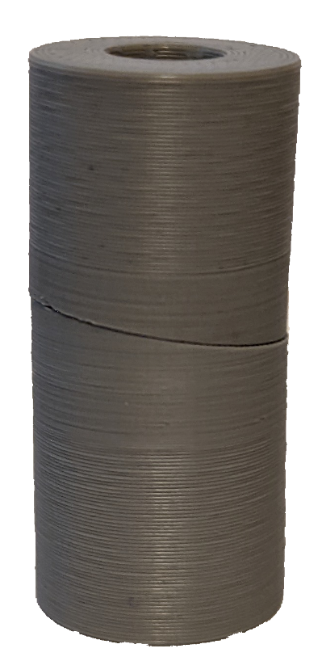
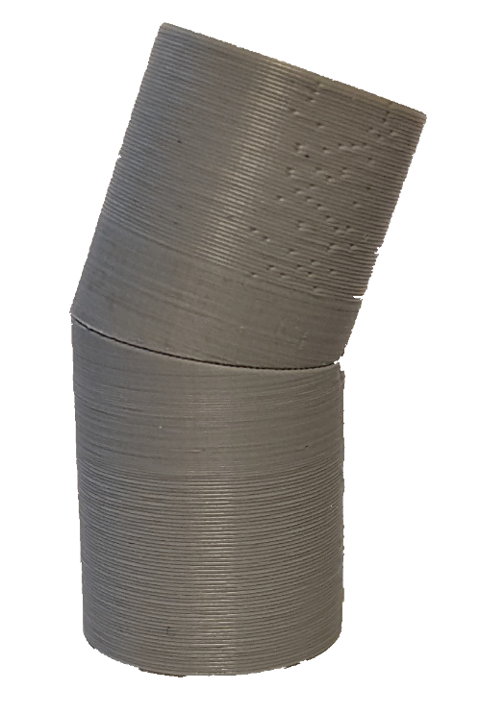

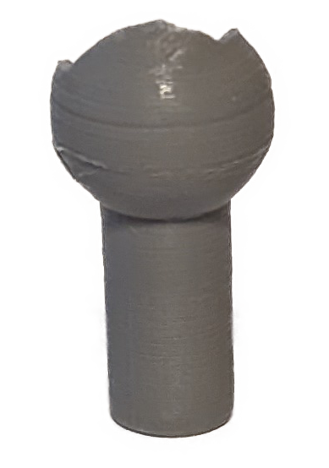
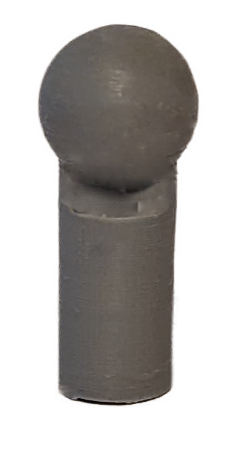

Concentric Surface Prototyping
10° concentric surfaces
Lessons learned:
Require a method to keep the surfaces in contact
Surfaces induce a significant amount of friction
20° of rotation achieved
Rotated 180°
Universal joint
Ball and socket pins
Noah Moffeit

Slide 16
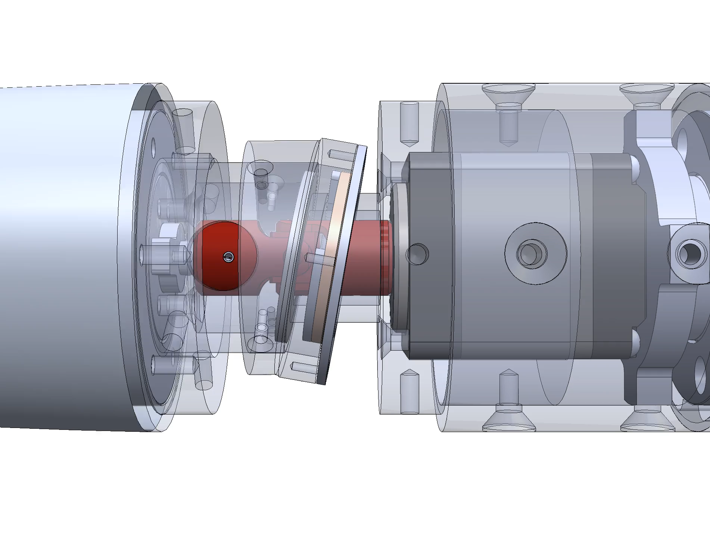
Contact Surface Operation
First motor turns the universal joint highlighted in red
  Allows for power translation to the nose
  Angled surfaces provide 20° of deflection
Second motor turns the deflected nose into desired position
Noah Moffeit

Slide 17
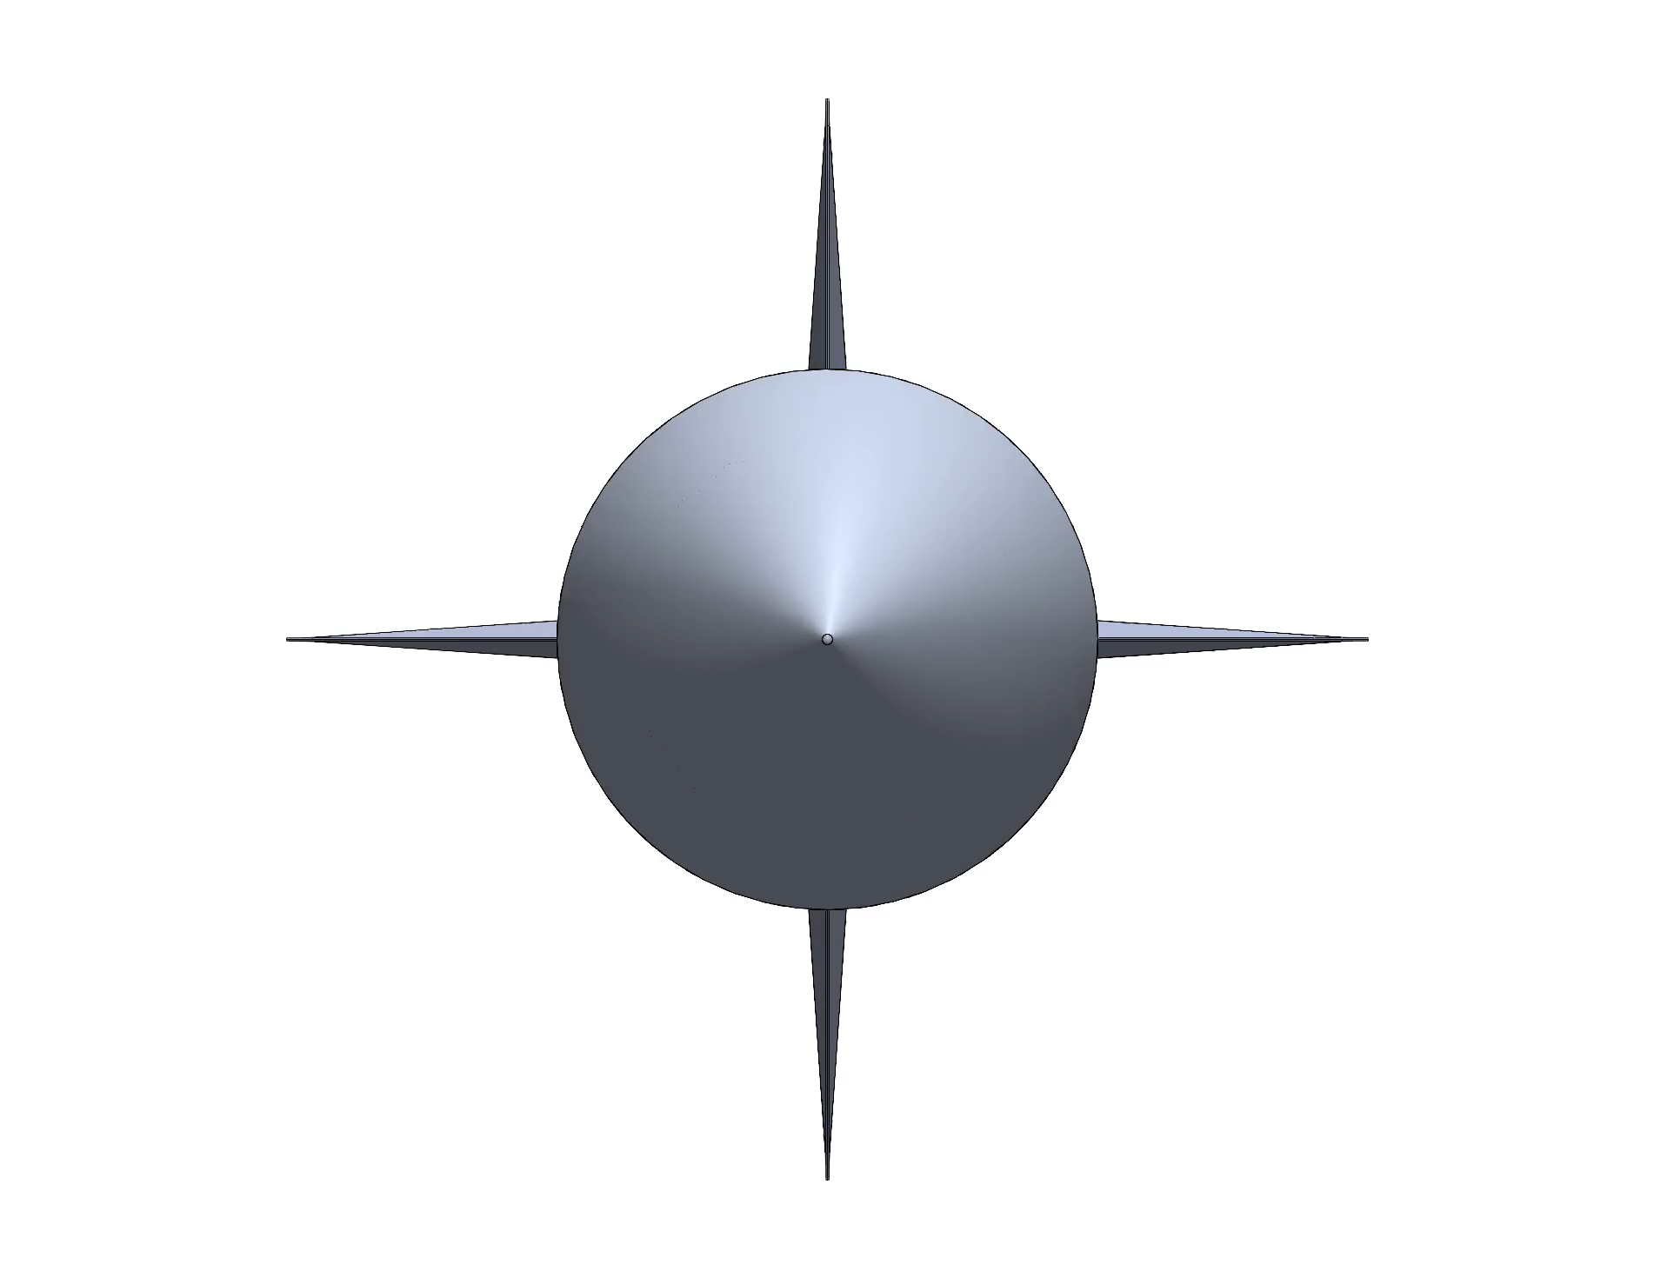
Nose Deflection Process
Operation allows for 20° of deflection
The deflection is then directed to the selected combination of pitch and yaw
  Current deflection process is nonlinear
Noah Moffeit

Slide 18
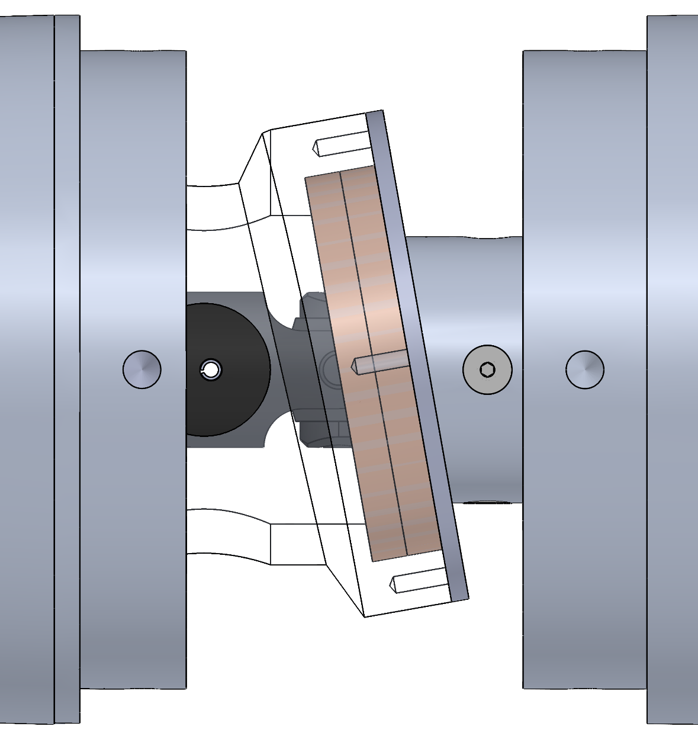
Reducing Friction
Compact volume restricted motor size and torque capability
Each moving component introduces additional friction
Solution:
  Custom washers at the contact surfaces
  Face-mounted bearings assist with rotation of outer components
Noah Moffeit

Slide 19
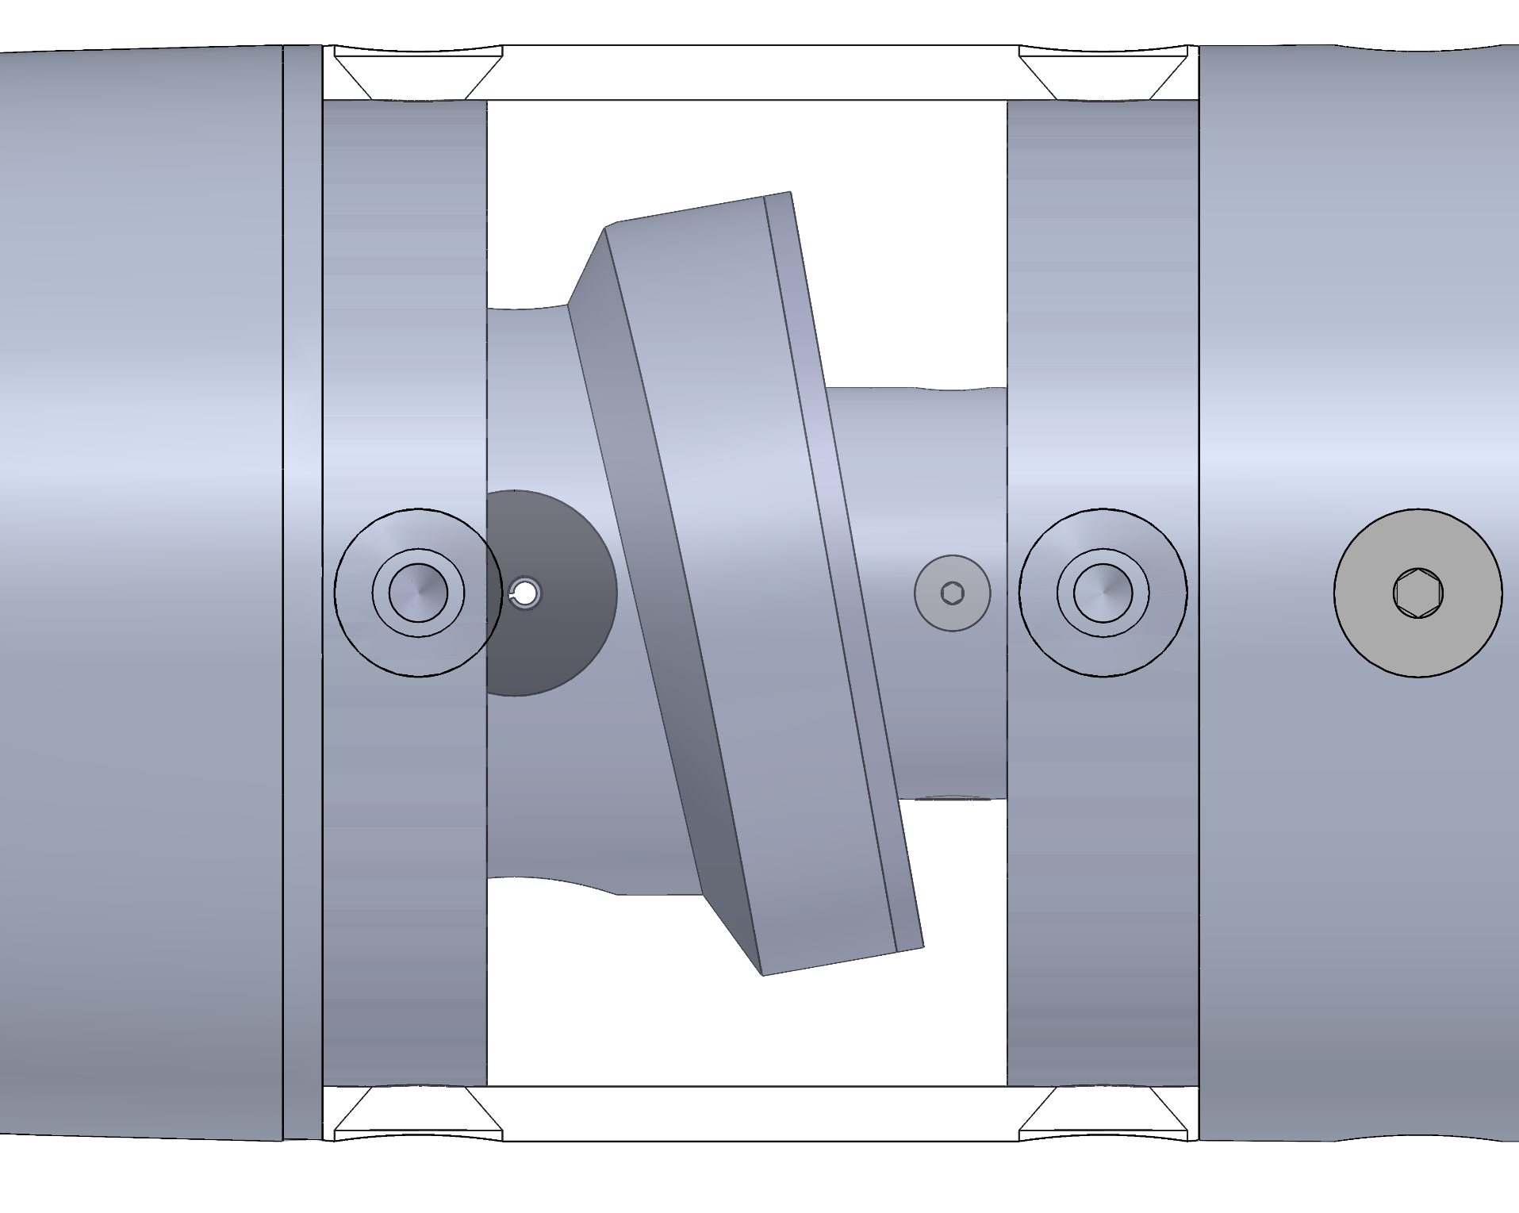
Gap Handling
Design introduces a significant gap
Gap could cause issues with stability of flow
Investigate flexible materials for the nose to body interface
  Silicon Resin mixture
  Single-Filament 3D print
  Multi-Filament 3D print
Noah Moffeit

Slide 20
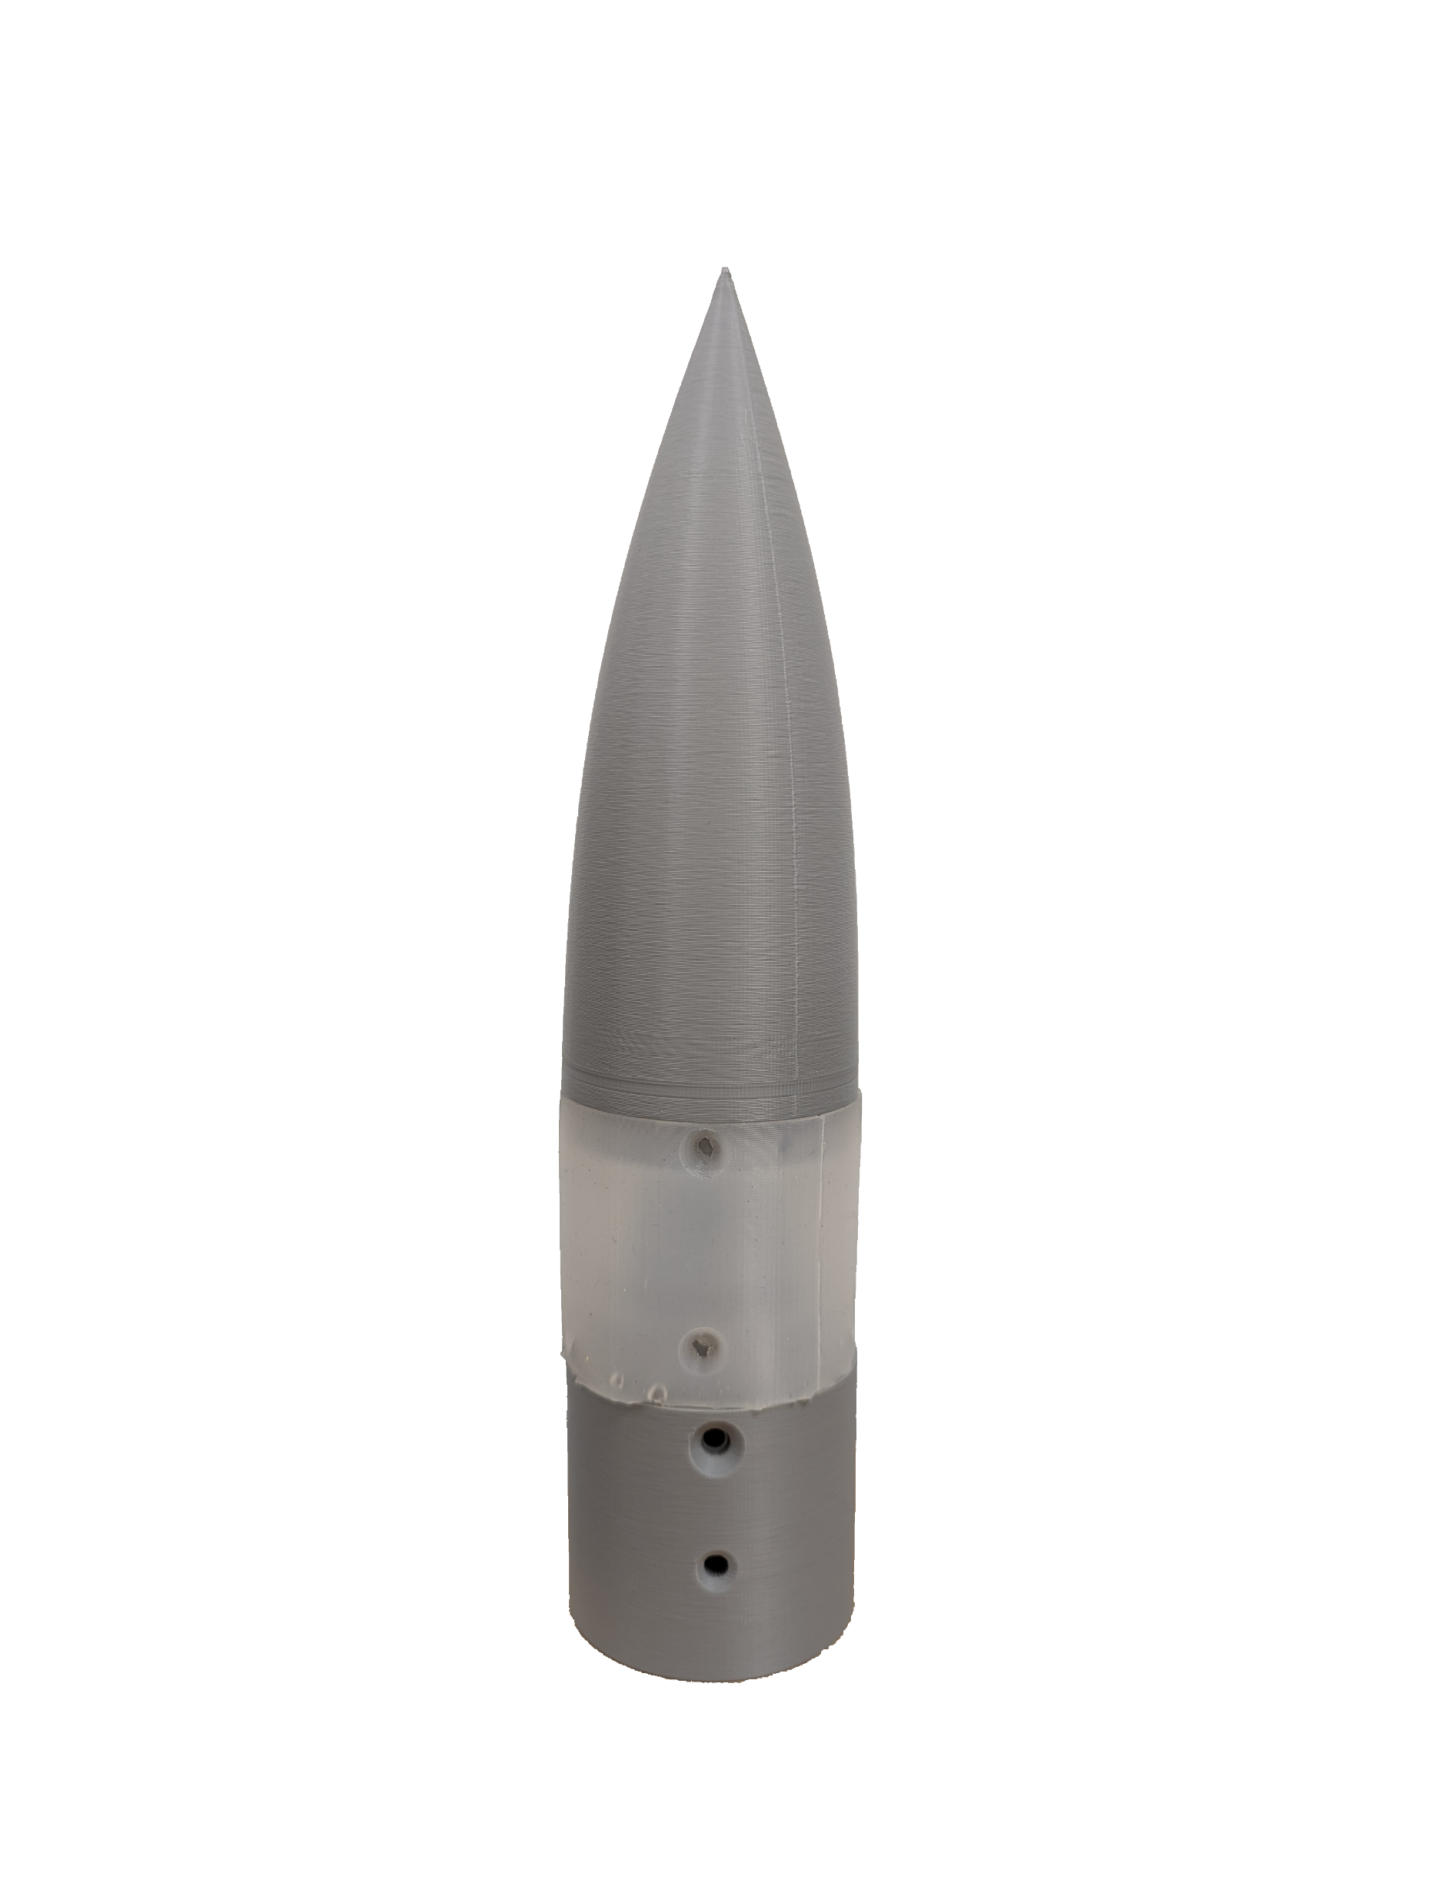
Gap Handling: Cast Silicone Resin
Required a 3D printed mold for casting
Greatest flexibility, least structure
  Pinching occurs at moderate to high deflection
  Capable of the greatest angles of deflection
Later prototypes introduce metal wire to facilitate structure
Noah Moffeit

Slide 21
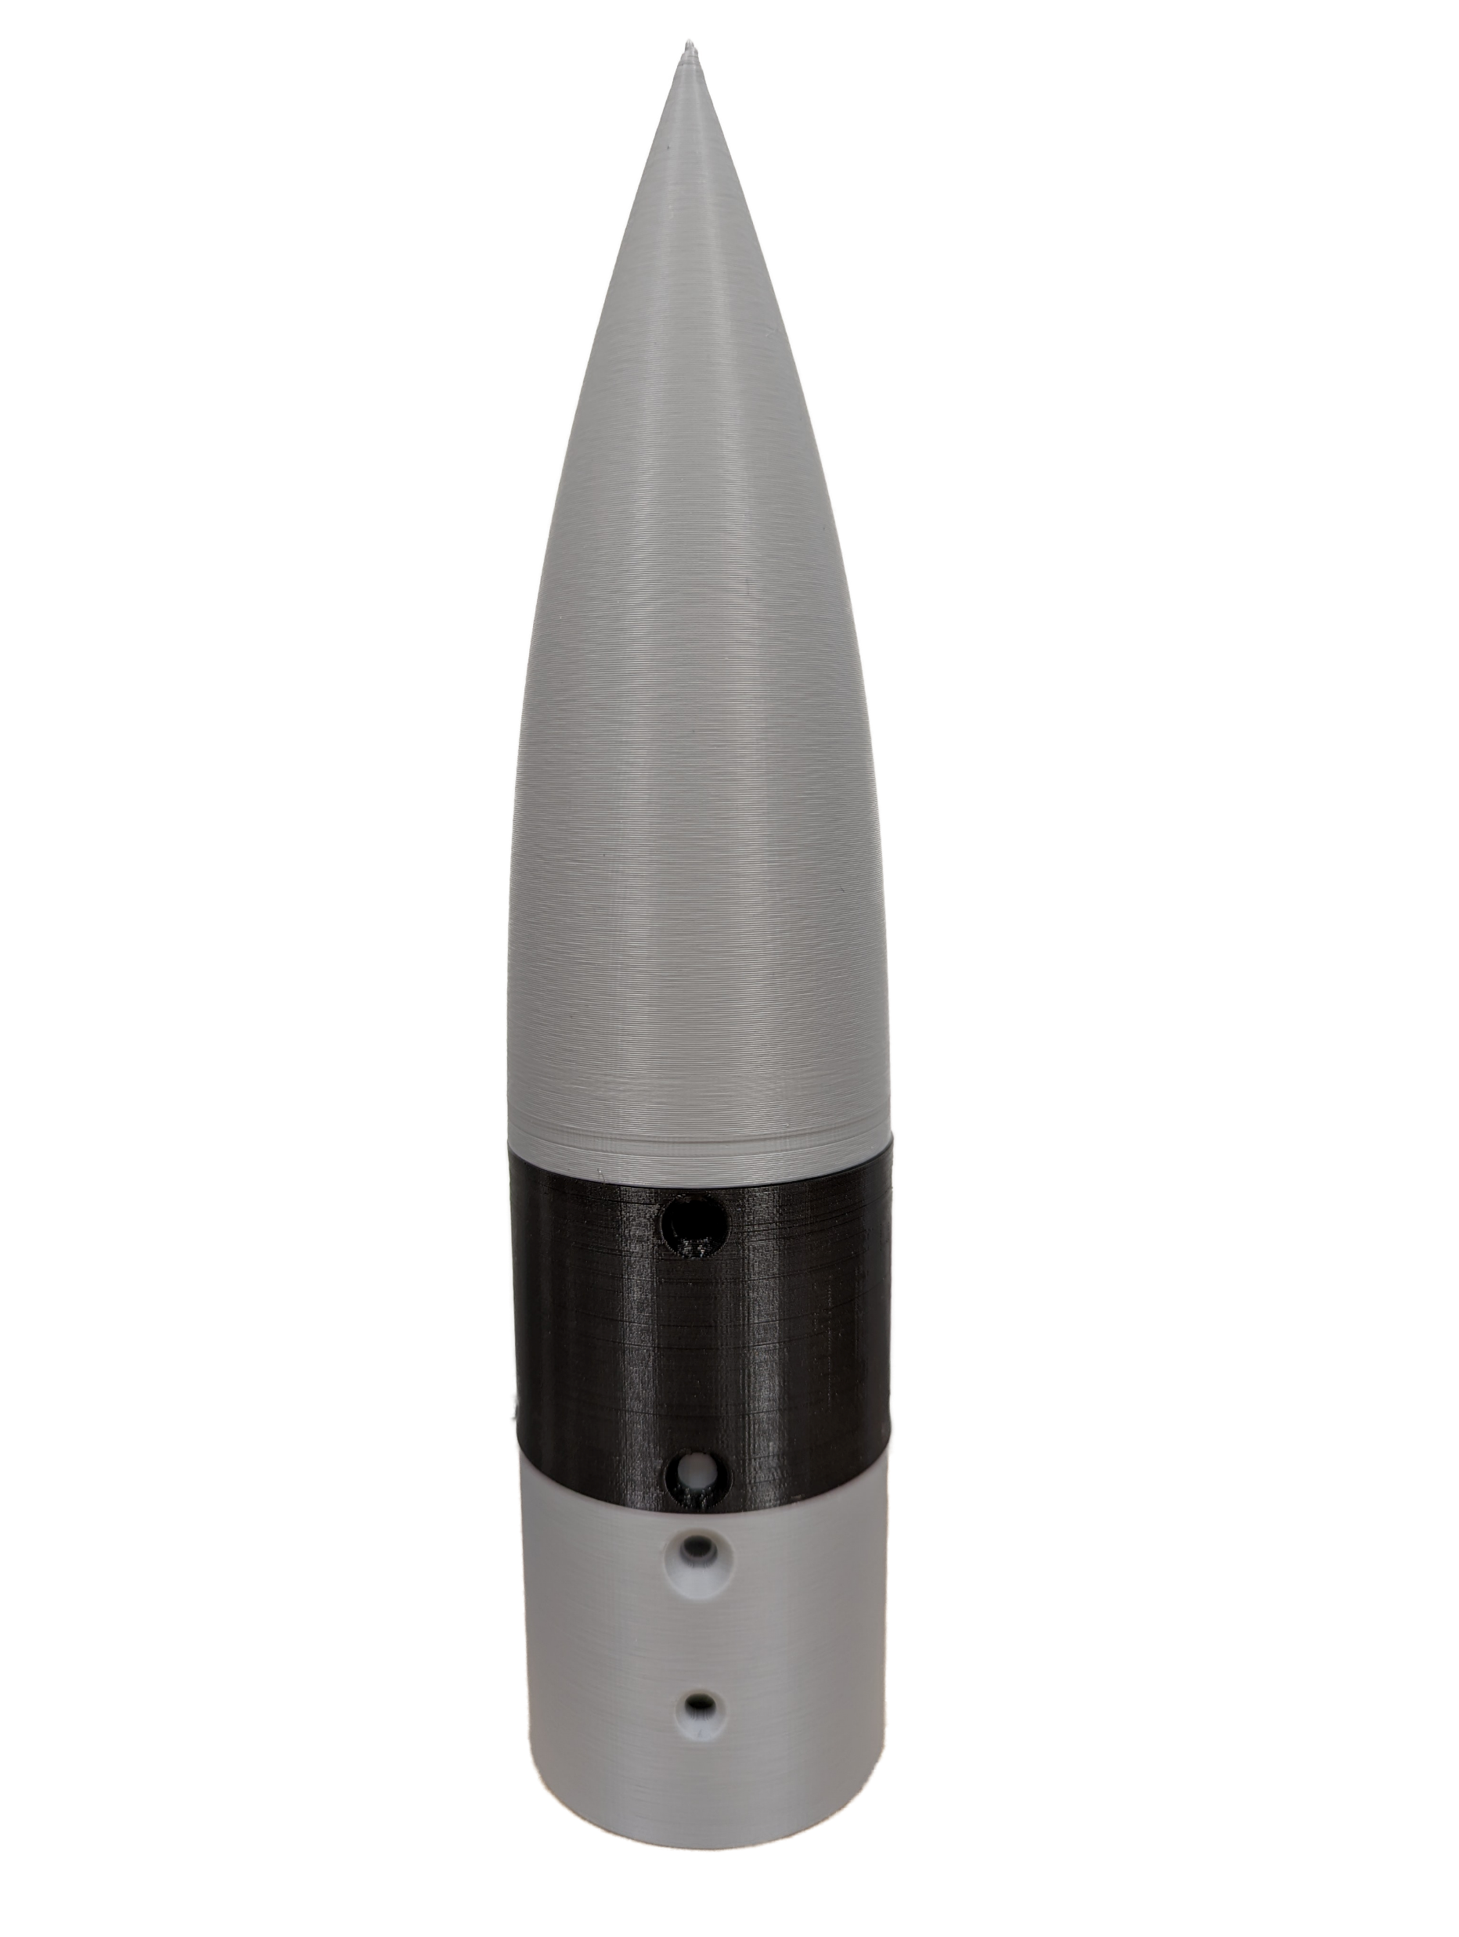
Gap Handling: Single-Filament 3D Print
NinjaFlex 3D Printer Filament
Capable of rapid prototyping
Allowed for bending without buckling
Least amount of flex
  Capable of only small angles of deflection
Noah Moffeit

Slide 22
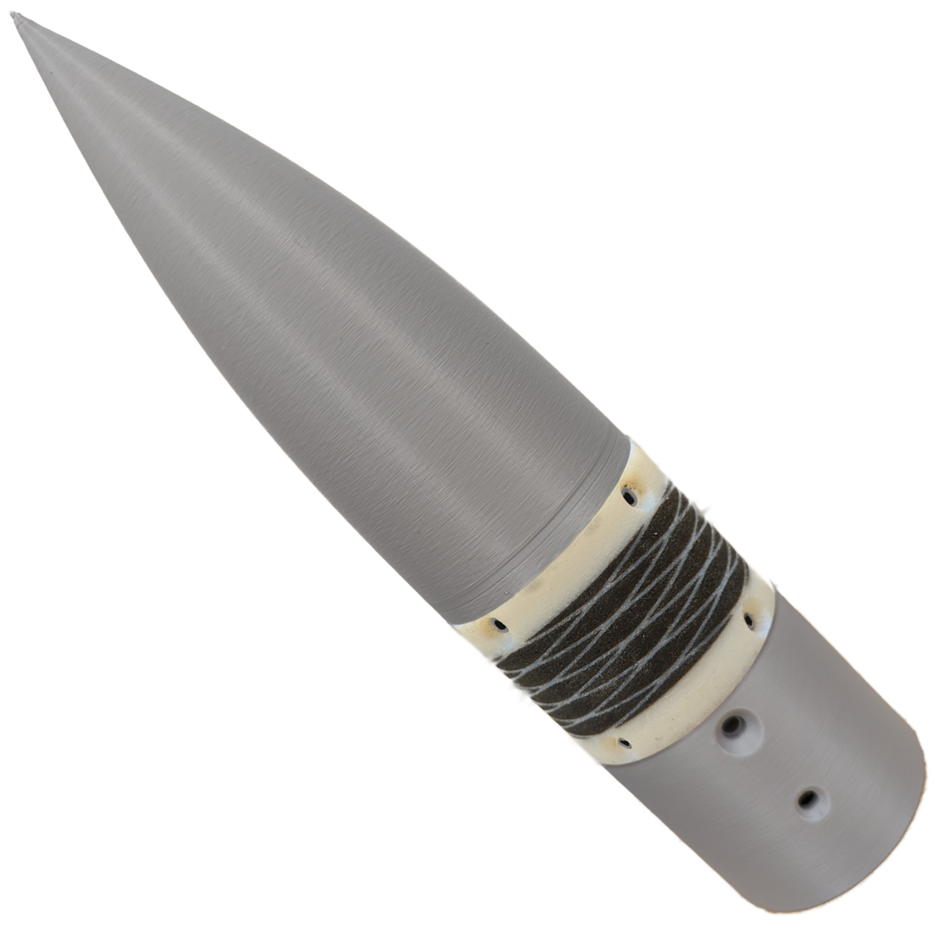
Gap Handling: Multi-Filament 3D Print
Provided by AFRL
  Used for AFRL’s missile models
Mixed material 3D print
  White: rigid
  Black: pliable
Allows for spring-like flexibility and provides structure
Noah Moffeit

Slide 23

Experimental Preparation
Calibrate motor rotation
Develop code to control
Sync rotation with data acquisition
Robert Smith

Slide 24
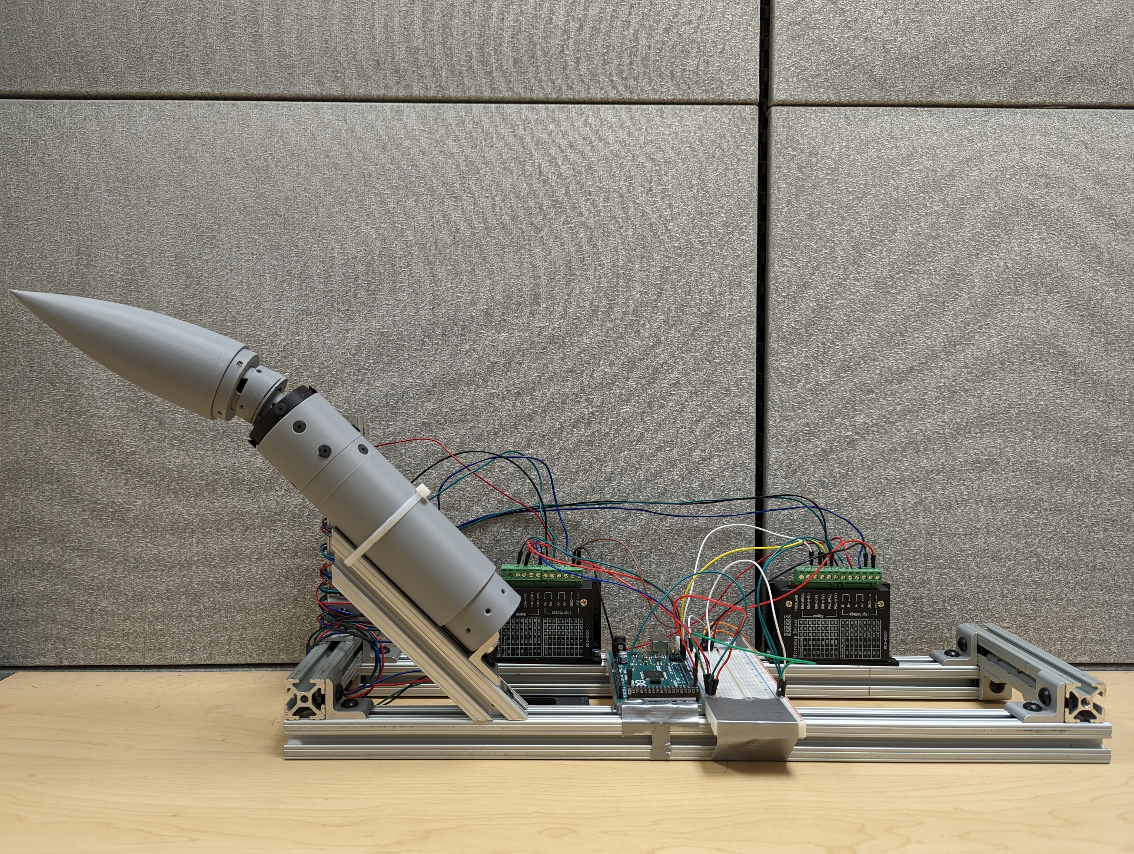
Benchtop Setup
3D Printed Model
Microstepping Controllers
Arduino Mega
Robert Smith

Slide 25
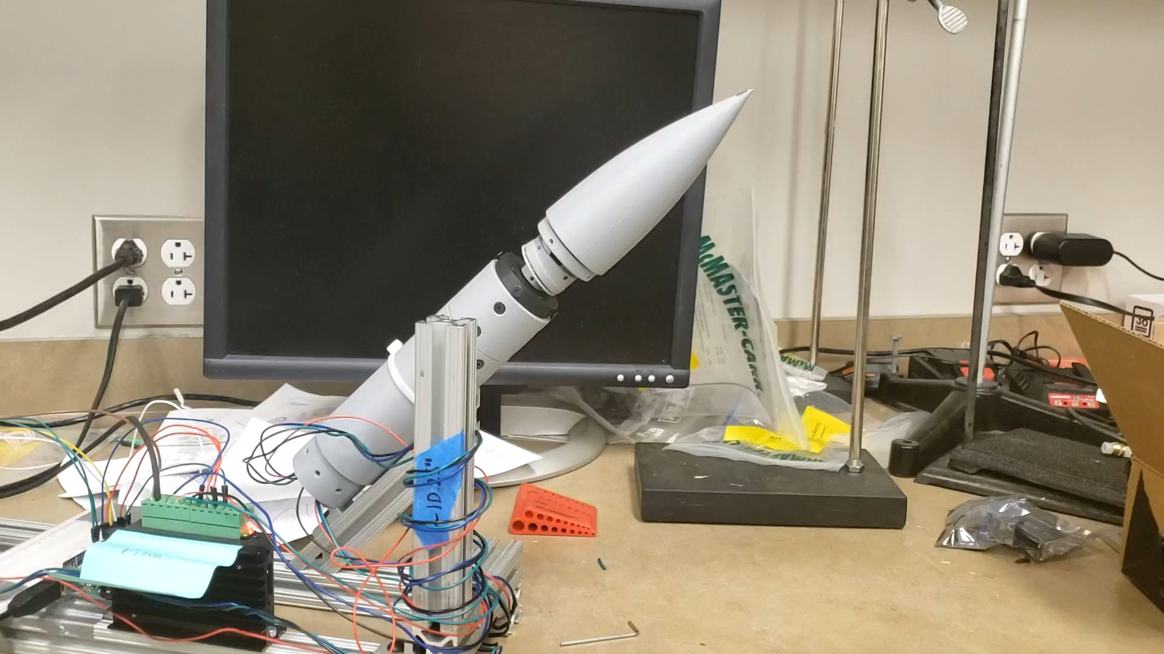
Benchtop Demonstration
Video shows nose pitching to 20° of deflection and rolling through 360° of motion
Controlled through Arduino
Microstepping was used to achieve motor rotation steps of 0.45°
Robert Smith

Slide 26
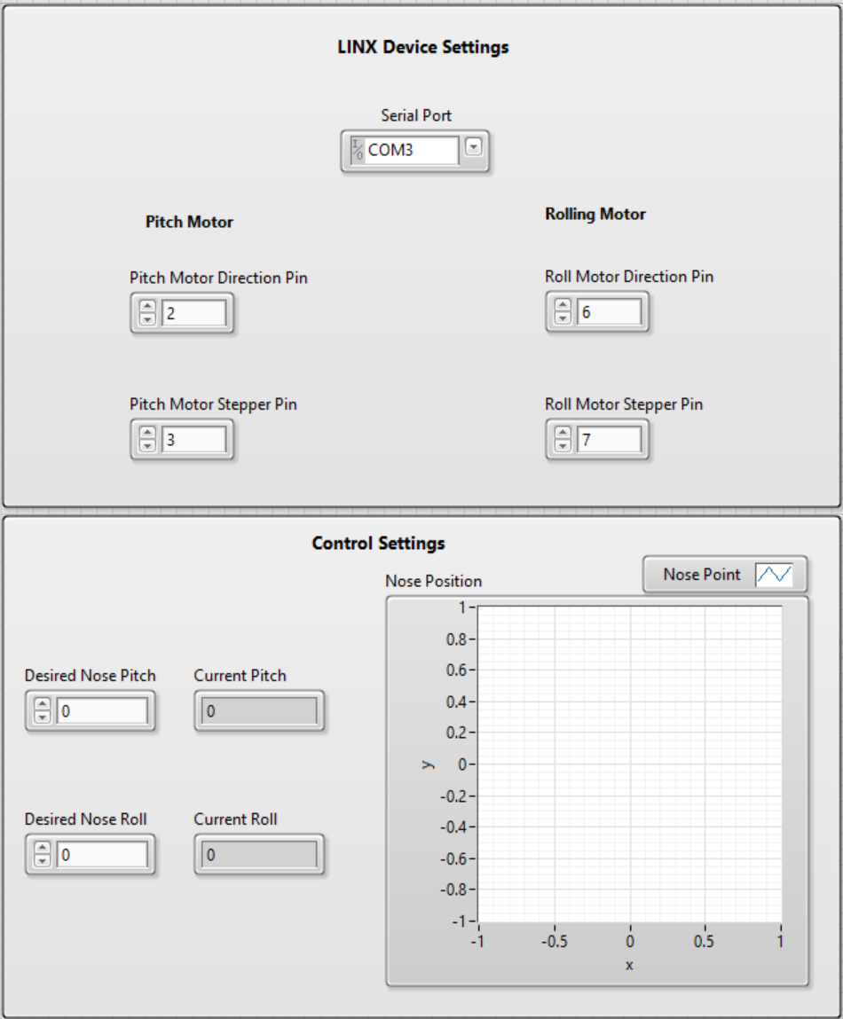
LabVIEW Setup
Allows for definition of connections pins and ports
User enters desired nose deflection and roll
  Square wave is sent to Arduino to reach position
Displays a graph showing the nose point of the cone translated to a 2D representation
Robert Smith

Slide 27

Planned Validation
Dot matrix used to validate that nose reaches desired angles
Given a known dot matrix distance, the angle can be determined through trigonometry
A matrix on two perpendicular sides would be used to validate that the nose achieves pitch and yaw angles
y
x
Robert Smith

Slide 28
Incomplete Work
Fully automated LabVIEW setup
Producing a linear motion path for the nose to travel
Testing the model in the wind tunnel
Analyzing impact of the deflected nose cone
Robert Smith

Slide 29
Lessons Learned
Get feedback from your sponsor any time you are unsure about your project
Prototype early to root out key design problems
Consistently check with the machinist to determine part machinability
Realizing that admitting your original choices were wrong is the fastest way to progress
Robert Smith

Slide 30
Summary
Objective
Create a mechanism that would allow for the articulation of a missile model’s nose cone
Design
We chose the concentric surface design after determining it was best suited to fulfill our needs
Incomplete Work
We were not able to test our model in the wind tunnel and obtain data
Targets
The goals for the project were to deflect a nose cone 20° with any combination of pitch or yaw
Outcome
The nose cone was successfully able to rotate to 20° and roll 360° about its centerline
Robert Smith

Slide 31
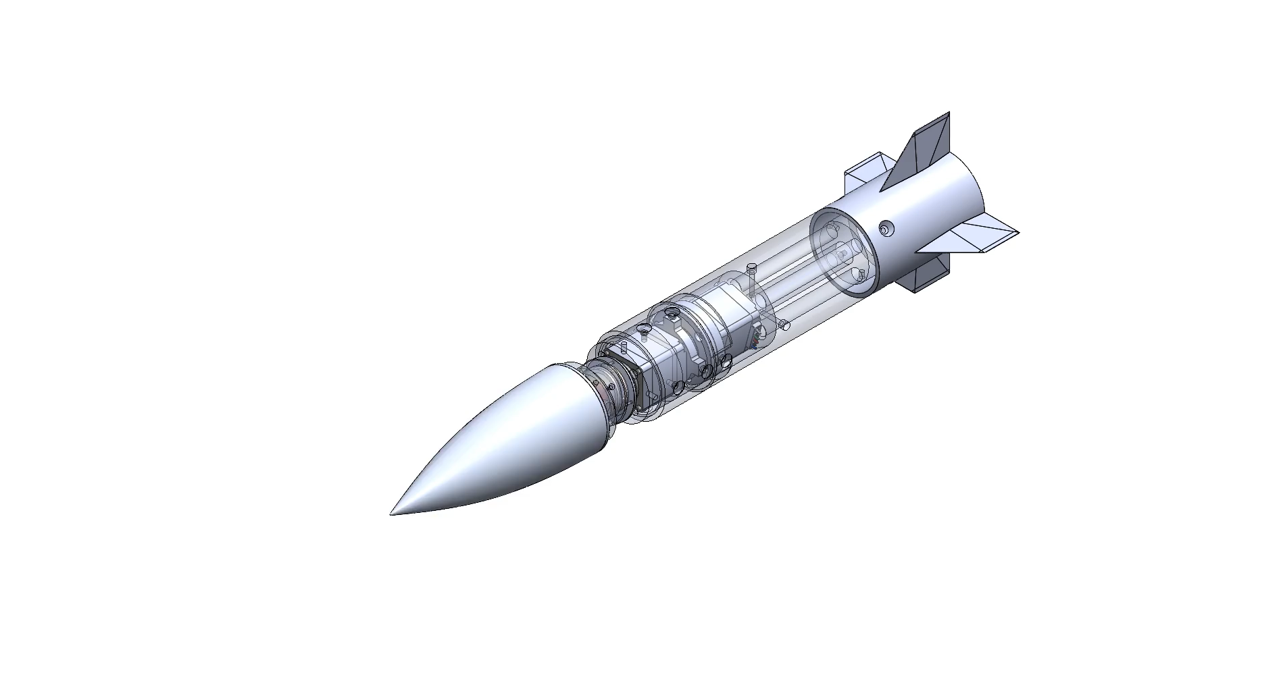
Thanks for listening
`
Jed Fazler
Robert Smith
Noah Moffeit
Nicholas
Samuda
Jed Fazler | Noah Moffeit | Nicholas Samuda | Robert Smith

Slide 32
Project Description and Key Goals
This project aims to create a technology that can be applied to many projectile configurations, allowing the projectile to maneuver adaptively through unforeseen, hazardous environments. The technology developed will detect said obstacles or conditions and actuate the projectile autonomously.
The key goals were selected to itemize the main objectives that must be accomplished over the duration of the project based on the project’s description and advice from the project’s sponsor. The following are the goals or milestones we have derived to ensure the project’s completion:
  Conceptualize and research 5 different innovative ways to maneuver a projectile.
  Choose one of these designs to expand upon and develop into a working design.
  Develop innovative technologies that can be implemented into the projectile allowing for smart capabilities.
  Develop a way for the projectile to adapt to its environment or obstacles through autonomous actions.
  Construct a scaled down model of the projectile for use in wind tunnel testing to verify desired aerodynamic characteristics of design.
  Construct a prototype projectile to test actuation of the smart functionality within the projectile.

Slide 33
Market
The primary market for this project was seen as the company or organization that the product would be directly constructed for and would use the product.
Primary Markets:
  Florida Center for Advanced Aero Propulsion (FCAAP)
The secondary markets are a makeup of other companies or organizations who may benefit from or would be interested in purchasing the results of this project.
Secondary Markets:
  Air Force Office of Scientific Research (AFOSR)
  Lockheed Martin
  Raytheon Technologies
  Northrop Grumman

Slide 34




Assumptions
Propulsion
It is assumed that:
Projectile deployment
Entailing storage
Transportation
Initial launch
will be facilitated by technologies already implemented in the projectile. It is also assumed that the projectile will remain within earth’s atmospheric conditions for its use.
Deployment
Storage

Slide 35
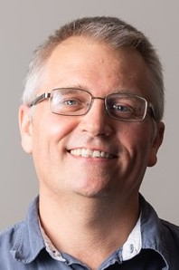
Stakeholders
The stakeholders for this project include all parties who will have influenced the design of the technologies produced by the project as well as those who have invested time and other resources into the project.
Dr. Shayne McConomy
Dr. Rajan Kumar
Dr. Jonas Gustavsson
FCAAP
FAMU-FSU College of Engineering

Slide 36
Customer Needs
How do you think current control surfaces and their actuation can be improved? | Current control surfaces require clean flow, which is not realistic at high angles of attack, so that’s something. | Projectile accommodates for attached flow over control surfaces.
What draw backs come with standard fin deflections as a control surface? | Must have clean flow to actuate properly. Size and weight that come with actuation mechanism | Projectile control surfaces will be suitable effective even in detached flow.
What Mach numbers would be expected for this projectile? | FCAAP polysonic wind tunnel can’t go faster than Mach 5. We’ll probably test Mach 4. | The projectile can withstand Mach 4.
What slenderness ratio of the projectile would be appropriate? | Would be nice if it could be tied into what we have done already. Matching a baseline design here at FCAAP. 8-10 | The projectile uses a basic axisymmetric body configuration based on previously tested models.

Slide 37
Customer Needs
Do we need to worry about designing the method of propulsion? | Don’t worry about designing the propulsion as we cannot have it modeled in the wind tunnel. | Propulsion is beyond the scope of this project.
By the end of this project, what level of manufacturing should be accomplished to demonstrate our results? | Small model for testing control surfaces in wind tunnel, larger model for demonstration purposes and sensing capabilities. Radar sensors possible option. | The projectile is modelled for aerodynamic testing and then prototyped for proof of actuation.
What conditions do you expect the projectile to operate in? | Projectile should go where the target goes. High angles of attack. Initial deployment shockwaves and vortices. Vibrations in supersonic can affect and disrupt the electronics. | The projectile has a way to rapidly adapt to the conditions that exist during deployment.
Should the projectile be able to actuate without user input? | Yes | The projectile is automatically operated.

Slide 38
Customer Needs
Should favorable aerodynamic characteristics be prioritized over functionality? | No, it should accomplish the task while minimizing negative effects. Compare to previous results. | Maintaining aerodynamic characteristics is secondary to maintaining control surface effectiveness.
What is considered a “harsh” or “hazardous” | Vortices, and shockwaves off the parent aircraft. High angles of attack | The missile adapts to high pitch angles.
What will be the preferred method of flow visualization? | It looks good. Better for showing actuation effects. Could be done with shadow graph in the wind tunnel. Not necessary but helpful. | Flow visualization will be done through other tests such as shadowgraph or oil flow.
Will the projectile also have to accommodate targeting? | Does not necessarily need to sense targets, could also sense high angles of attack. | The missile can sense its angle of attack in various scenarios.

Slide 39
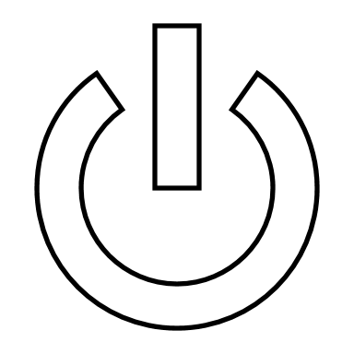

Functional Decomposition
Storage
Provides power for components
POWER
Transmission
Transfers power to components
Jed Fazler

Slide 40

Functional Decomposition
Sensors
Monitors sensor data
SENSING
Interprets sensor data
Signaling
Transmits response signal
Jed Fazler

Slide 41
Functional Decomposition
Flow
Maintains flow attachment
Controls pitch
ACTUATION
Mechanical
Controls roll
Controls yaw
Jed Fazler

Slide 42
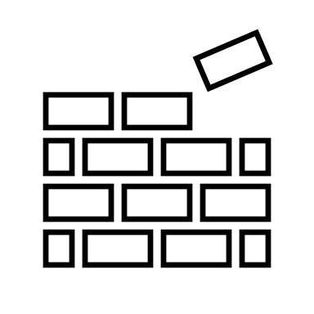
Functional Decomposition
Maintains integrity
STRUCTURE
Protects components
Jed Fazler

Slide 43
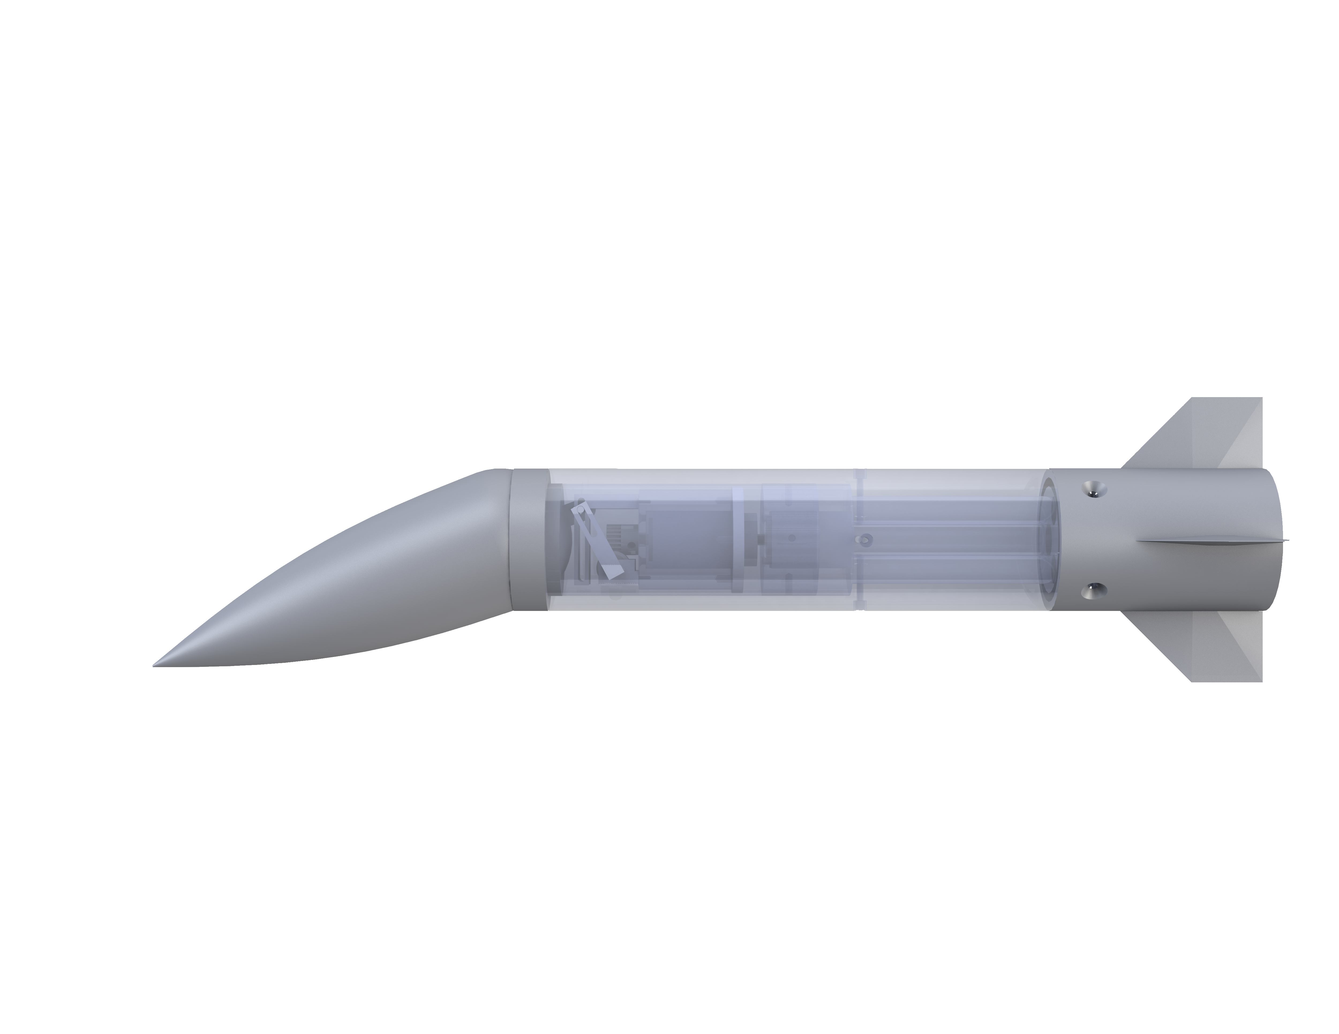
Polar Control Model
4
1
6
4
1
Pin Holders
Worm Gear
3
2
5
Spur Gear
Sliding Pin
3
Pin Slot Link
6
Motor Mount
5
2
7
7
Stepper Motor
Nicholas Samuda

Slide 44

Jed Fazler
Noah Moffeit
Robert Smith
Nicholas
Samuda

Slide 45
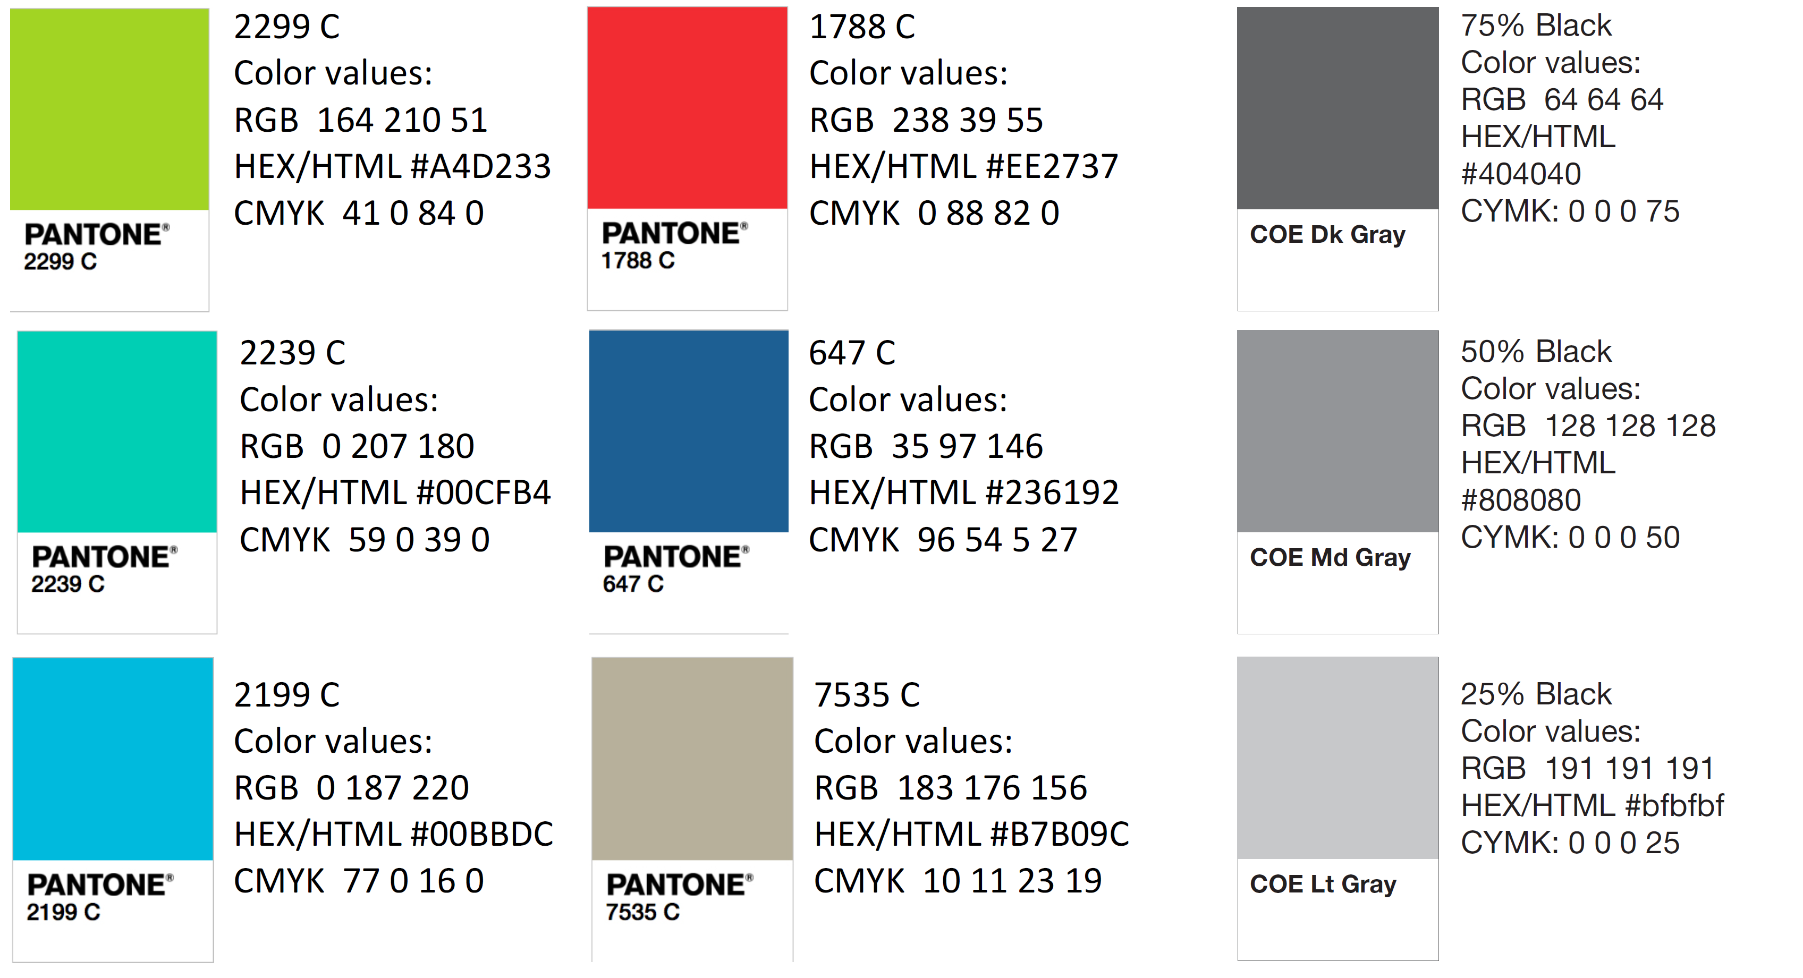
Color Palette
How do you think current control surfaces and their actuation can be improved? | Current control surfaces require clean flow, which is not realistic at high angles of attack, so that’s something. | Projectile accommodates for attached flow over control surfaces.
What draw backs come with standard fin deflections as a control surface? | Must have clean flow to actuate properly. Size and weight that come with actuation mechanism | Projectile control surfaces will be suitable effective even in detached flow.
What Mach numbers would be expected for this projectile? | FCAAP polysonic wind tunnel can’t go faster than Mach 5. We’ll probably test Mach 4. | The projectile can withstand Mach 4.
What slenderness ratio of the projectile would be appropriate? | Would be nice if it could be tied into what we have done already. Matching a baseline design here at FCAAP. 8-10 | The projectile uses a basic axisymmetric body configuration based on previously tested models.

Slide 46
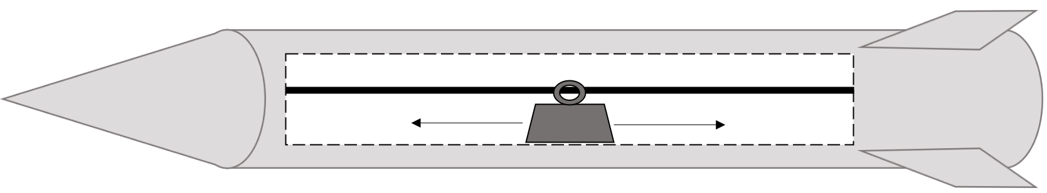
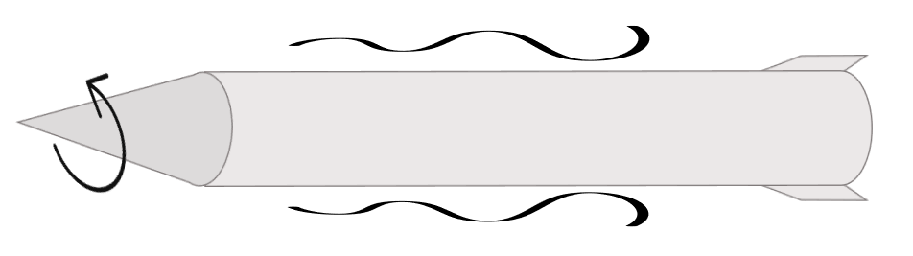
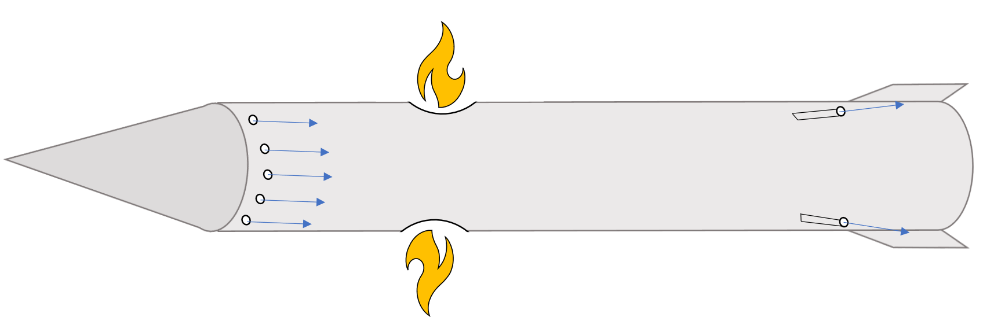
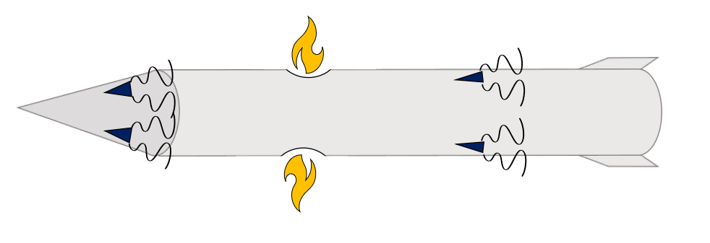
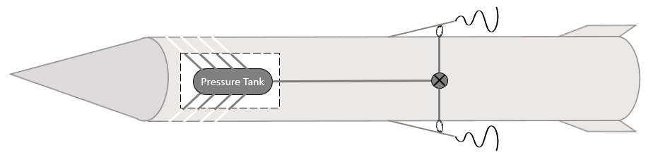

Slide 47
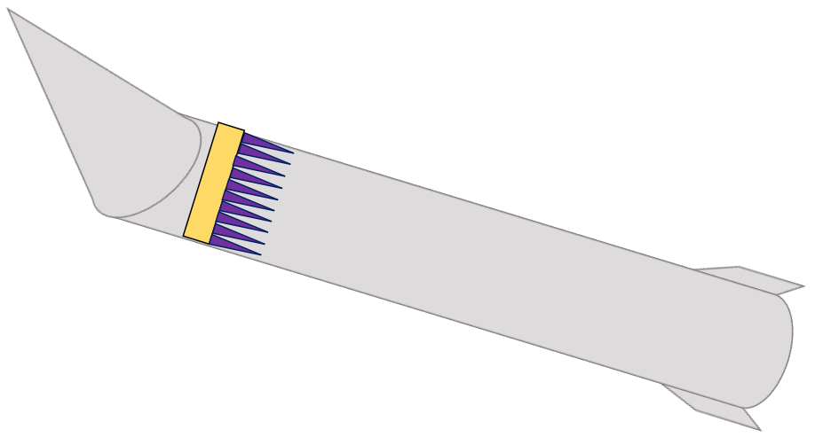
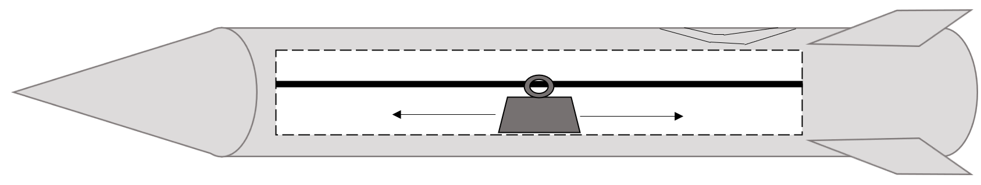
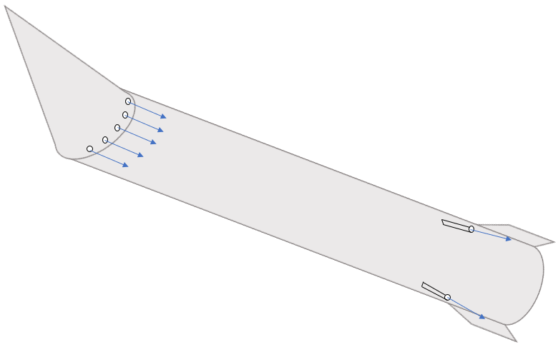

Slide 50
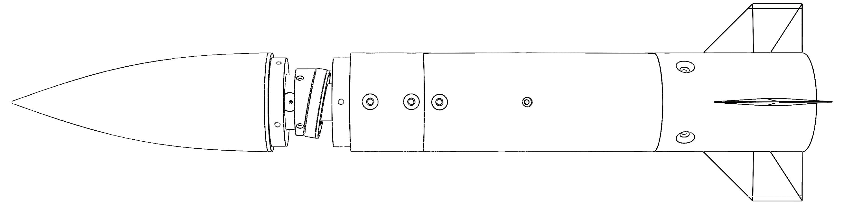

Slide 51
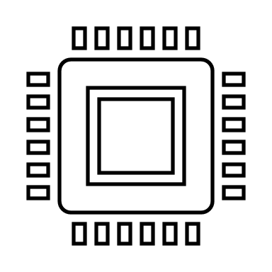
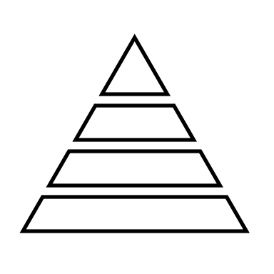
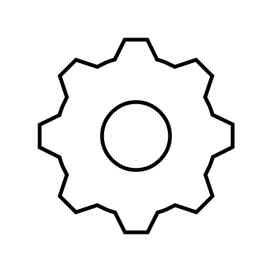

Slide 52
Nose Pulleys
Linear Actuators
Rotating Contact Surfaces
2 DOF Gear Box
Polar Controller
Basic Rotating Nose
Robert Smith

